Slide 1
Psychological Perspectives of Opioid Use and Cognitive Behavior Treatment
William G. Kee, PhD
Charleston Psychological Associates

Slide 2
OBJECTIVES
Explain multidimensional aspects of chronic pain
Discuss problems with opioid therapy
Discuss physician options for assessing and treating
contributing/problematic factors in opioid therapy
Evaluate the value of Cognitive/Behavior therapy in treating chronic pain
Explain treatment components of Cognitive/Behavior
Therapy

Slide 3
48 million people in US
Little relief from current medications
Medications have potential for harmful side effects
Depression 4% to 66%
Estimated cost Chronic pain $215 Billion Depression $80 Billion
Co-occurrence associated with more disability and poorer prognosis
Greenberg and Birnbaum 2003

Slide 4
BIOPSYCHOSOCIAL MODEL
Most comprehensive
HOW PAIN IS ASSESSED?
Unique
Individualized
Complex interaction of biological, psychological, social factors
Allows for interdisciplinary treatment
Medicine, PT, Psych, Behavioral health
Gatchel 2004; Turk and Rudy 1987;Wright and Gatchel 2002

Slide 5
BIOPSYCHOSOCIAL MODEL
Cognitive-Behavior Therapy is treatment that addresses all aspects of Bio-Psychosocial Model
Standard of care for patients with chronic pain
Better than wait list control group or medical management
Significant changes seen
patient’s pain experience
Improved cognition and coping
Improved activity level
Behaviors around pain issues are better
Improved social role functioning
DISADVANTAGES
Regarded as last resort
All other medical interventions undertaken and failed

Slide 6
NAVIGATING THE HEALTH CARE SYSTEM
Misuse/overuse of opioids
Deconditioning
Obesity
Sleep disturbance
Poor body mechanics and posture
Lack of social support, communication, social stress
Unhelpful coping strategies
a. Catastrophising
b. Fear/avoidance
c. Overgeneralization
8. Depression and anxiety
These problems can actually increase pain by contributing to tissue damage and increasing psychosocial problems

Slide 7
Case Example--- Sarah 31 year old English Professor
Likes gardening, dancing, horseback riding
--acute onset of pain while gardening
--conservative treatment – rest, stop exercises (deconditioning)
--CT Scan – herniated disc (source of nociception)
--NSAID, mild opioid (medication)
--Neurosurgeon recommended surgery
--Opted for PT and medication
--Nightmares about wheelchair confinement (sleep deprivation)
--Frightened about surgery (autonomic arousal)
--Had to stop work (short term disability)
--SURGERY able to function on increased medication
--Gradual return to work, gardening, dancing, horseback riding
--Still on medication

Slide 8
TWO MONTHS LATER
--Sharp pain increase (Started in leg after hiking)
--Middle of night awakening (sleep deprivation)
--Back spasms (source of nociception)
--Consult surgeon “Nothing abnormal on MRI” (anxiety)
Non-operable, Recommends full activity
--”I am in pain, why can’t they find something?” (negative thoughts)
“Am I making this up? Is it all in my head?”
Sarah unable to do housework or pleasant activities
--Resting when not at work (deconditioning)
--Impatient with students and friends (irritable)
--Constantly talks to friends about pain (decreased social support)
--Feels exhausted, alone, defective, miserable, unlovable
--Feels out of control of body (helpless, depressed)

Slide 9
Second Neurosurgical Opinion
--Myelogram (no disc herniation)
--Recommends stabilization with spinal fusion
--Sarah is desperate but agrees to surgery
–no change in pain, unable to work (medication increased, disability)
--Disability insurance representative hassles her about paperwork
--MD has not filled in paperwork (stressed, panic)
Sarah’s Family Doctor tells her “Live with pain”
Referred to Psychologist “It’s all in my head” (desperate, anxious)
Caudill, 1995

Slide 10
OPIOID MEDICATIONS
**Growing use with increasing controversy
**Side effects
1. hyperalgesia
2. hypogonadism
3. sexual dysfunction
Despite possible benefits 2.8% to 62.2 % of patients may exhibit problematic use
CHRONIC USEAGE
1. tolerance
2. dependence
3. potential for misuse or addiction

Slide 11
“ PROBLEMS IN OPIOID MANAGEMENT”
----Many MDs prescribing opioids have little training in addiction or aberrant
drug related behavior
----Recent trend in Pain Management Physicians and Centers is preference
for injections or intervention only
----Risks in writing prescriptions DHEC scrutiny of MD behaviors and license
jeopardy
----Poor insurance/Medicare reimbursement for “med check” visits
Turk, Swanson, Tunks 2008

Slide 12
****** TOLERANCE*******
Physiologic changes result in increased need to accomplish same level of
pain relief
Can also cause side effects such as sedation, nausea, respiratory depression
Occurrence is variable and does not of itself imply addiction
******DEPENDENCE ******
Syndrome of unpleasant physical symptoms which can occur if medication
abruptly stopped
It is an expected occurrence in the presence of continued opioid use
--nausea --vomiting --sweating
Possible emotional dependence and cognitive side effects
-- fear of pain --fear lack of control
If abruptly stopped , may lead to
-- depression --insomnia

Slide 13
****** ABUSE *****
----primary, neurobiological disease
opioids cause changes in limbic system’s mediation by dopamine
----Development influenced by genetic, psychosocial, environmental factors
----Characterized by craving, impaired control, compulsive use, continued
use despite harm
----Can lead to harmful behavior with physical, social , and legal
consequences
Jamison, Butler, Budman, 2010

Slide 14
APPROACHES TO MANAGEMENT
--Optimal use of opioids must include evaluation of risks associated with
potential abuse
--Opioid misuse may indicate treatment adherence issues or more serious
behavioral problems
Screening Devices to determine risk potential
Screener and Opioid Assessment for Pain Patients (SOAPR-R)
24 item self-administered screening instrument (Butler, Buchner, et al 2004)
2. Prescription Drug Use Questionnaire (PDUQ)
Structured 20 minute interview with patient (Savage 2002)
3. Prescription Opioid Therapy Questionnaire (POTQ)
13 item questionnaire completed by physician (Michna, Ross, et al 2004)
4. Screening for Addiction in Patients/ Problematic substance abuse
(yes/no) questionnaire with cut off values (Compton, Darakjian, and Miotto
1998)

Slide 15
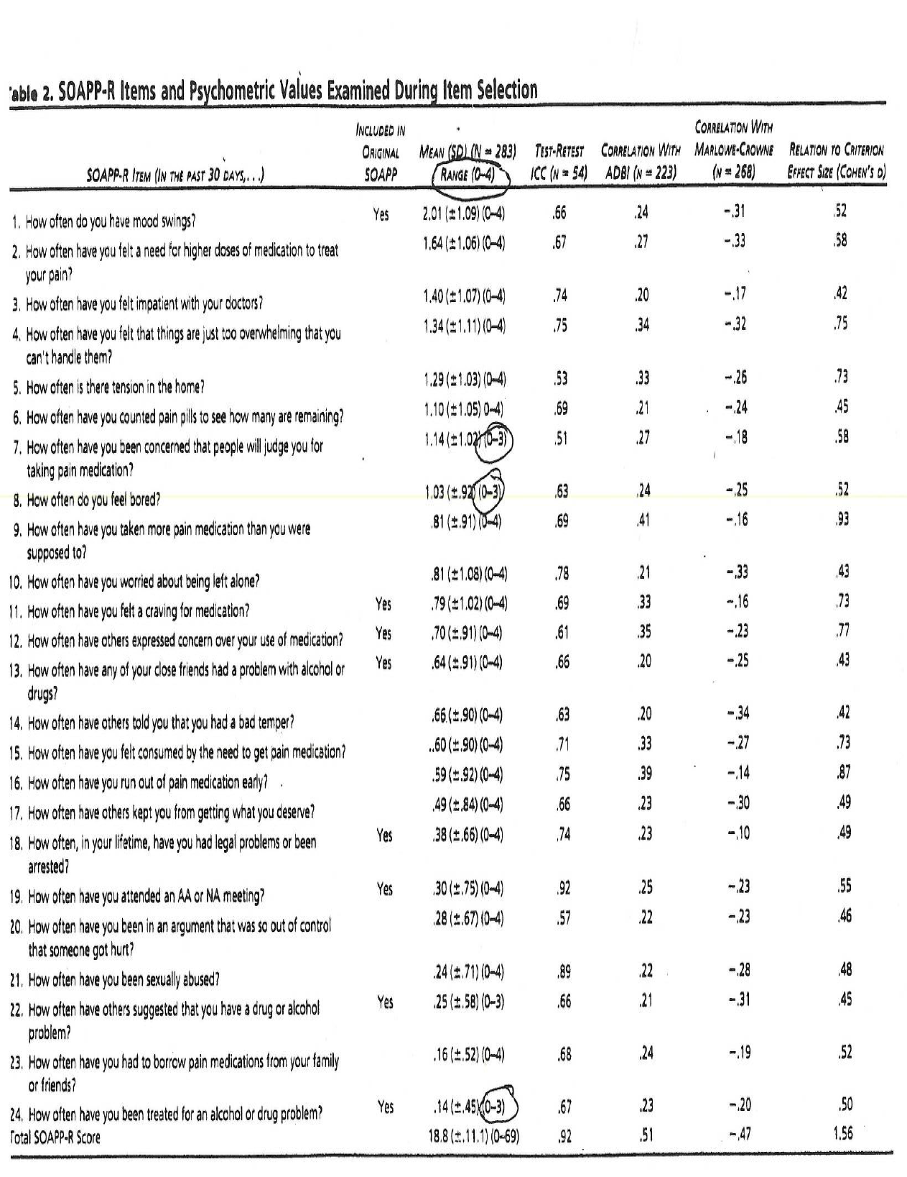

Slide 16
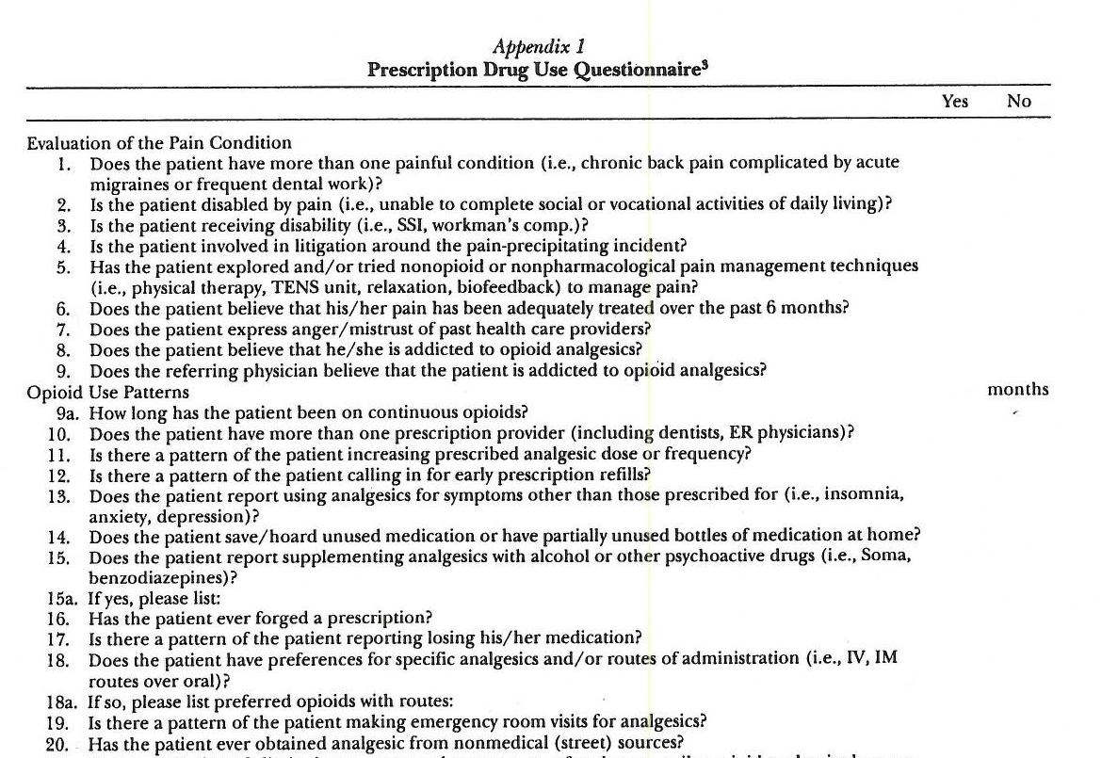

Slide 17
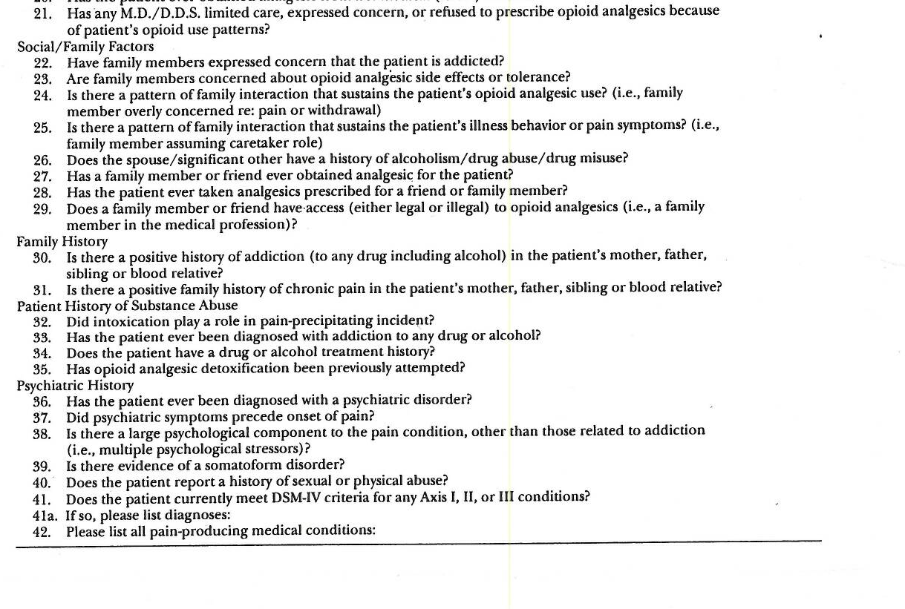

Slide 18
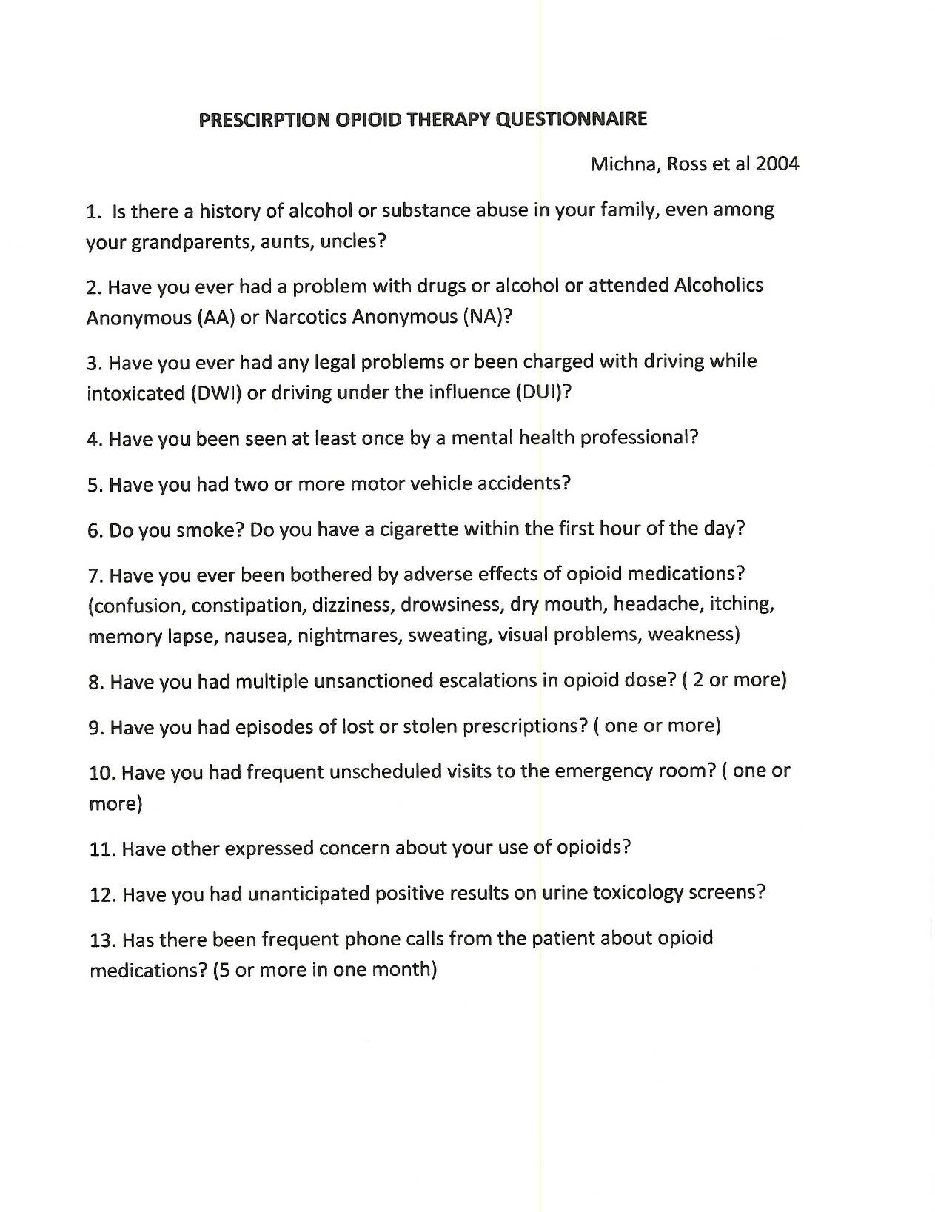

Slide 19
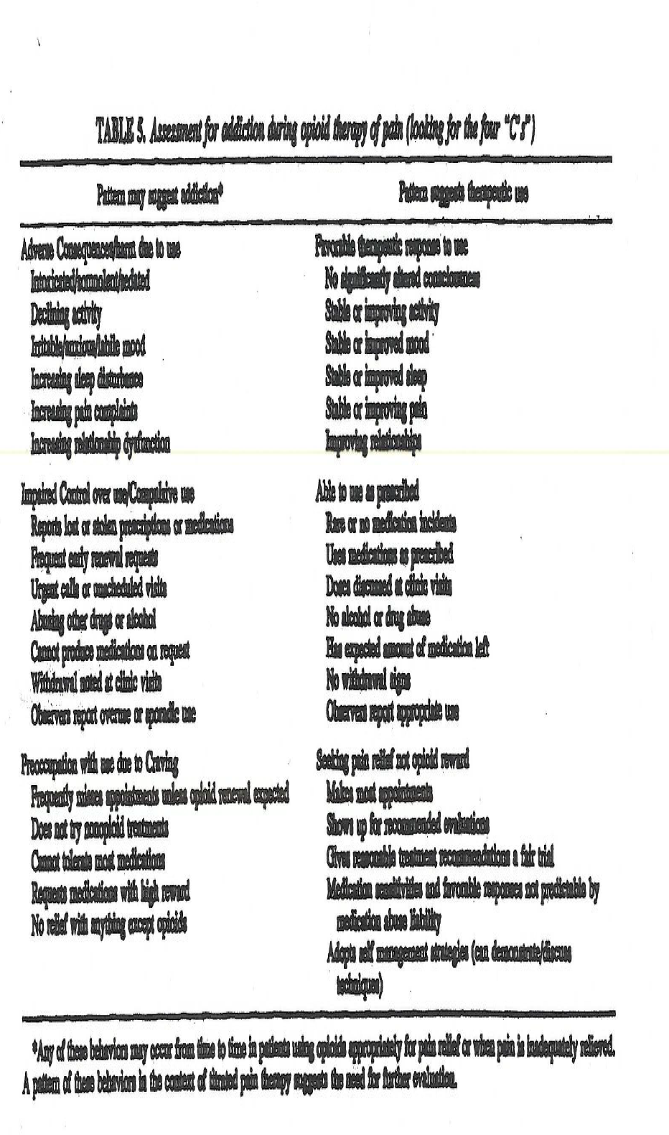

Slide 20
MANAGEMENT
--Regular urine toxicology screen
determine compliance, presence of illicit substances
--Risk Factors for Aberrant Prescription Use ----- 3 clusters of variables
History of substance abuse
History of legal problems
History of psychiatric problems

Slide 21
MODIFIED TREATMENT APPROACH
One or more risk factors indicate need for modified treatment
------------Narcotic Agreement to Include-------------
Psychological evaluation and treatment
Closer monitoring of behaviors including monthly urine screen and pill counts
Education by psychologist concerning avoiding opioids as a way to deal with anxiety, stress, or sleep disorder
Stress importance of compliance with “narcotic contract”
how to keep opioids secure
compliance with behavioral and cognitive regimens to control pain
improve coping and functioning
--exercise --relaxation --psychotherapy

Slide 22
COGNITIVE BEHAVIOR THERAPY
Why is it necessary?
People in chronic pain are more depressed than the general population
Pain interferes with mood when it interrupts important life domains
work, recreation, social relations
3. Intrapersonal resources are important in coping with pain
Self esteem fosters control and mastery
buffers against chronic stressors (Turk, Okifuji, Scharff 1995)
Better self esteem is linked to better adjustment, lower depression, and less helplessness
in people with a variety of health problems (Tait 1999)
Better self esteem in pain patients associated with less pain
less interference of pain in activity
better mood
Should patients interpret pain catastrophically, they develop
pain related fear/activity avoidance
physical disuse and long-term disability (Leeuw, Groosseus et al, 2007)

Slide 23
COGNITIVE BEHAVIOR THERAPY (CBT)
--Psychotherapeutic approach that addresses
Dysfunctional emotions –depression, anxiety, anger
Maladaptive behavioral patterns
Maladaptive cognition/thinking AUTHORS AND DEVELOPERS
Edward Thorndike
--Uses goal oriented, systematic procedures B.F. Skinner
to return patients to work, full functioning Cognitive Therapy of Aaron
in life Beck --CBT is effective in a variety of conditions Rational Emotional Therapy
Mood, anxiety, chronic pain of Albert Ellis
Personality disorders
Fibromyalgia
Substance use disorders
CBT and Health Care
Treatment programs for specific disorders have been evaluated for efficacy
The health care trend of Evidence Based Medicine has favored CBT over
psychodynamic approaches where specific treatments for symptom
based diagnoses are recommended

Slide 24
MALADAPTIVE BEHAVIOR PATTERNS
Strategies for change using different interventions
Self-instructional
Demonstration
Goal setting
Desensitization
Training in alternative positive strategies (i.e. relaxation)

Slide 25
BEHAVIORAL PROBLEMS IN MANAGEMENT
DECONDITIONING
-- Even after extensive workup, 85% of cases lack established cause for
musculoskeletal pain (Hicks, et al 2002)
-- Pain at multiple sites leads to increased likelihood of chronic pain (Croft, et al
2006)
-- Pain at multiple sites associated in linear fashion with poor physical condition,
impairment, psychological problems, poor sleep quality (Kalmaleri et al,
2008)
--Leads to increased risk of long term work disability and treatment and
disability costs
Deconditioning Solutions
-- Alternate behaviors
-- Daily stretching exercises
-- At least 3 times weekly strengthening and aerobic exercising on land or using
aqua therapy
-- Activity pacing
Concept of “uptime” and “downtime”
“threshold vs tolerance”
Alternate behaviors -- sit, stand, walk, recline

Slide 26
OBESITY
Greater body mass index (BMI) associated with greater number of pain complaints
Increased number of pain sites
Tender point sensitivity
Poorer quality of life
Reduced physical functioning in patients with chronic pain (fibromyalgia)
(Yunas, Arslan, Aldag 2002)
WEIGHT LOSS PROGRAMS
Weight Watchers
Paleo diet
Medical supervision of liquid diet
Bariatric Surgery

Slide 27
SLEEP DISTURBANCE
--chronic pain patients show decrease in REM sleep associated with
impairment of attention control
impairment of working memory
impairment of mental flexibility
impairment of problem solving
--disturbed sleep architecture contributes to
increased sensitivity at pain sites
increased sensitivity at tender points
increased fatigue
increased depression
increased stress
SOLUTIONS
Sedating Anti-Depressant Medication
Evaluation of sleep postures (pillows, mattress, postural alignment)
Relaxation, Guided imagery, Self-hypnosis

Slide 28
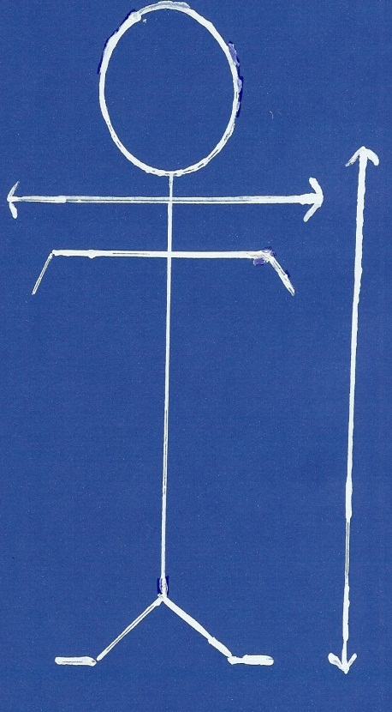
POOR BODY MECHANICS AND POSTURE
--Antalgic Gait
Shoulder up with cane
Weight shifted one leg
Shortened steps
--Guarding
Shift weight to avoid painful area (sit or stand)
--Bracing
Muscle tension in response to pain or in anticipation of pain
INSURING CORRECT SPINAL ALIGNMENT IS VERY IMPORTANT
STAND --- weight balanced on both feet
ear over shoulder over hip
load balanced on spine, pelvic tilt (flexion vs extension)
SITTING ---90 degree angles at waist, at knee
use footstool, lumbar support, cervical support
LIFTING --- leg broad base, lift with knees, head up and spine straight
Golfer’s lift

Slide 29
PREMISE OF MAINSTREAM CBT-----------------Change dysfunctional thinking
Dysfunctional thinking (influences person’s mood, behavior, physiologic
functioning)
Leads to change in affect or behavior ( remember Sarah?)
Patients develop automatic/habitual thoughts---”I can’t accomplish anything!”
Can lead to reaction of feeling sad (emotion) or retreating to your bed
(behavior If this process occurs repeatedly, it can lead to physical deconditioning and
distorted sleep pattern. (Judith Beck, 2008)
The GOAL: 1. Recognize “errors” or negative thought patterns
2. Replace these patterns with realistic more effective thoughts
3. Decrease emotional distress and self-defeating behavior

Slide 30
Life is Painful,
Suffering is Optional.
Sylvia Boorstein

Slide 31
Common Negative Thought Patters Seen in Chronic Pain Patients
Catastrophising -- Fortune Telling -- one predicts worse outcome
Learn to look at realistic odds, and ask what else can happen?
Overgeneralization -- take one negative experience and generalize,
One bad situation predicts similar bad experience in a similar situation
Look for evidence for or against your conclusion, then alter you conclusion
Mindreading -- you assume from small piece of information what someone’s
thoughts/motivations are
Check it out and require evidence for your conclusion

Slide 32
NEGATIVE THOUGHT PATTERNS ----- “SELF TALK”
Patterns are automatic, occur quickly, like incomplete sentences
Example: Wake up, first attempt to get out of bed. The pain is still there.
“I can’t stand it anymore!” “No one cares!” “I am useless/
worthless”
Result: worry, sadness, depression
This is negative “self talk”. -- Inaccurate, irrational, exaggerated, catastrophic,
all or nothing
SOLUTION: Challenge exaggerated statements --
There are things you can do even with pain
You don’t have to let your day be miserable
What does that have to do with people caring for you?
Caudill 2002

Slide 33
REFRAMING TECHNIQUE
State the problem: “ I am awakening in pain.”
State why it is a problem: “ I had planned to visit a friend today.”
IDENTFY:
What can I do? I will see how I feel after taking a shower,
stretching, practicing my relaxation, using ice and TENS unit
What do you need? I could ask my friend to come here, or
we could meet somewhere close, or
we could visit at another time.
Realistic self calming – Pain flare-ups do happen
Flare-ups are usually self-limited
I know what I can do to take care of myself
How do you feel? Sad but hopeful; In control

Slide 34
PROGRESSIVE MUSCLE RELAXATION
Comfortable position either seated or reclining
Eyes closed, internal gaze
Flex-relax slowly through muscles of body
feet, legs, hips, abdomen, hands, shoulders,
neck (3 directions), forehead, around eyes, jaws
Abdominal breathing
“strong” “calm”
Pleasant place – seated comfortably , warmth of sun on chest and arms, beach, meadows, mountains with stream, “Special Place” that only patient knows about
Suggestion For mastery: Breathe “strong-calm”

Slide 35
GUIDED IMAGERY
Comfortable position – eyes closed
5 deep breaths
Shape -- pain is what shape?
Color -- pain is what color?
Texture - pain is what texture?
Shape, Color, Texture grow as large as it can -- finger signal
Shape, Color, Texture gets smaller and smaller -- finger signal
Repeat process 2 more times
Shape, Color, Texture -- smaller -- See it roll down one leg all the way to toe, then kick it into the far distance.
3 more deep breaths
Open eyes

Slide 36
****** SELF-HYPNOSIS ******
State of “inner absorption”, concentration, focused attention
Allows concentration and focus therefore using more potential
Act of self-control
Differing views on how it works
“hypnotizability” as a trait
Strong cognitive / interpersonal component -- response to suggestion
Dissociation – people with early trauma, personality disorder
hypnosis can be an abusive tool with them
Fairgrounds

Slide 37
USES FOR CLINICAL HYPNOSIS
Imaginative, mental imagery -- Powerful in focused state
Mind is capable of using imagery (often symbolic) to bring out capabilities,
person is imagining (sports, achieved goals)
Unconscious exploration to better understand or identify whether past events or trauma are associated with exacerbation or contributing to present emotional state or problems
Avoids critical conscious thought
Allows personal intention for change to take effect
Trauma associated memories are not admissible as evidence in court
Medical hypnosis can be used to assist with ---
pain control/ pain associated with severe burns
gastrointestinal disorders (ulcer/irritable bowel syndrome)
headaches
hypertension
Medical Procedures –surgery, child birth, dentistry
Brain imaging studies using functional MRI and PET scans demonstrate a number of brain structures associated in pain perception (e.g. somatosensory cortex, anterior cingulate cortex, insula) are demonstrably changed through hypnotic suggestion.
(Stroelb, Molten, Jensen, et al 2008)

Slide 38
SELF-HYPNOSIS PROCESS
Teaches person to put themselves in a trance
Induction – eye fixation, eye roll, arm levitation, arm catalepsy, relaxation
Deepening -- walk down stairs, ride escalator, float on cloud, counting
Pain control Techniques --Anesthesia – cold/numbness (painful leg in cool stream or lake, glove
anesthesia)
--Dissociation -- putting self in another time and place
Vivid daydream – floating on a cloud or in a boat --Altered Sensation/ transformation – cover area of pain with thick layers of
padding -- Pain turns to pressure --Displacing pain -- displace pain to another area of body, then to outside the
body
--Post Hypnotic Suggestion – Cues -- associate relief to deep breathing,
seeing number 11 or two parallel lines
--Anchoring -- touch self on shoulder or make “OK” finger sign when in trance
and re-experience pain relief

Slide 39
CONCLUSIONS
Chronic pain is a multifaceted problem involving biological, social, psychological factors
Research shows optimal treatment of chronic pain is from an early onset team approach which addresses all patient needs (not just medication, epidural blocks)
Physicians will best manage opioid therapy if psychological/social background issues are assessed and treated from the onset
Cognitive/Behavior Therapy provides a value added component in returning patients to work, helping physicians manage patients, and moving their treatment forward

