Slide 1
BENEFITS OF OPIOIDS FOR PAIN MANGEMENT
DAVID S. ROGERS, M.D.

Slide 2
PAIN PREVALENCE
100 million adults in the U.S.
31 % of the adult population
34 % female adults
27 % male patients
26 % of adults in the U.S. with depression
N.I.H.

Slide 3
UNDERTREATMENT OF PAIN
42% E.D. patients present with pain
75 % leave the E.D. in mod-severe pain
40% never receive analgesics
86% patients after surgery report mod-
to severe pain

Slide 4
CONSEQUENCES OF UNTREATED PAIN
“Unrelieved pain has negative physical and psychological consequences. Aggressive pain prevention and control that occurs before, during, and after surgery can yield both short-term and long-term benefits.”
AHCPR Clinical Practice Guidelines- Acute Pain Management
“Unrelieved pain has enormous physiological and psychological effects on the patient. The Joint Commission believes that effective management of pain is a crucial component of good care. Research clearly shows that unrelieved pain can slow recovery, create burdens for patients and their families, and increase costs to the health care system.”
Dennis O’Leary, M.D. President, JCAHO

Slide 5
PAIN
WEBSTER'S Definition of PAIN
A: a state of physical, emotional, or mental lack of well-being or physical, emotional, or mental uneasiness that ranges from mild discomfort or dull distress to acute often unbearable agony, may be generalized or localized, and is the consequence of being injured or hurt physically or mentally or of some derangement of or lack of equilibrium in the physical or mental functions (as through disease), and that usually produces a reaction of wanting to avoid, escape, or destroy the causative factor and its effects. B : a basic bodily sensation that is induced by a noxious stimulus, is received by naked nerve endings, is characterized by physical discomfort (as pricking, throbbing, or aching), and typically leads to evasive action.

Slide 6
OPIOID DEFINITION
1. any synthetic narcotic that has opiate-like activities but is not derived from opium.
2. any of a group of naturally occurring peptides, e.g., enkephalins, that bind at or otherwise influence opiate receptors, either with opiate-like or opiate antagonist effects.

Slide 7
MOST WIDELY PRESCRIBED DRUG CLASS
1 OPIOIDS
2 ANTIDEPRESSANTS
3 LIPID AGENTS
NIH – NIDA data
Science Daily April 6, 2011

Slide 8
This sort of press is a direct
consequence of our refusal
to take a hard, responsible,
unbiased view of these
very strong,
very problematic,
and potentially deadly
compounds

Slide 9
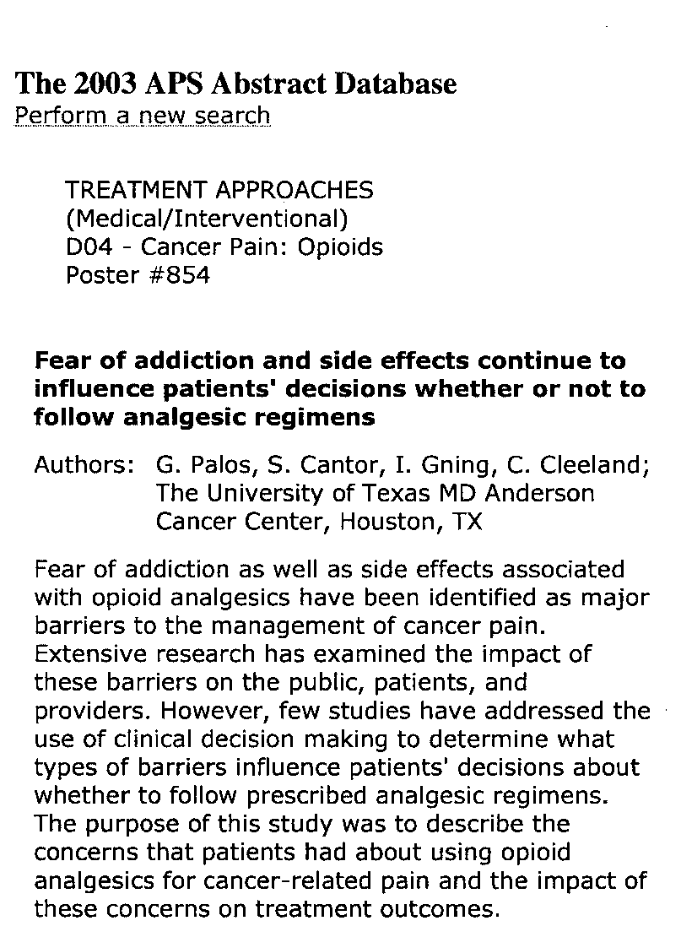

Slide 10
OPIOID CONCERNS
Physical dependence
Psychological dependence
Addiction
Abuse
Diversion

Slide 11
Abuse:
Source: SAMHSA 1999-2001 NHSDAs

Slide 12
ABUSE AND ADDICTION
Rare as a rule in chronic pain patients
but …no appropriate studies of chronic pain populations over long term.

Slide 13
Important Questions
Risk:Benifit (Efficacy) ratio?
Abuse and Addiction?
Tolerance?
Psychological Risks?
Cognitive Risks?
Palliation vs. Rehabilitation?

Slide 14
Adverse Events (PDR)
Body as a Whole:
Asthenia, accidental injury, fever, pain, chest pain, headache, diaphoresis, chills, flu syndrome, back pain, malaise, withdrawal syndrome
Cardiovascular:
Tachycardia, atrial fibrillation, hypotension, hypertension, pallor, facial flushing, palpitations, bradycardia, syncope
Central Nervous System:
Confusion, dry mouth, anxiety, abnormal thinking, abnormal dreams, lethargy, depression, tremor, loss of concentration, insomnia, amnesia, paresthesia, agitation, vertigo, food drop, ataxia, hypesthesia, slurred speech, hallucinations, vasodilitation, euphoria, apathy, seizures, myoclonus
Endocrine:
Hyponatremia due to inappropriate ADH secretion, gynecomastia
Gastrointestinal:
Vomiting, anorexia, dysphagia, dyspepsia, diarrhea, abdominal pain, stomach atony disorder, gastroesophageal reflux, delayed gastric emptying, billary colic
Blood & Lymphatic:
Anemia, leukopenia, thrombocytopenia
Metabolic & Nutritional:
Peripheral edema, hyponatremia, edema
Musculoskeletal:
Back pain, bone pain, arthralgia
Respiratory:
Hiccup, rhinitis, atelectasis, asthma, hypoxia, dyspnea, respiratory insufficiency, voice alteration, depressed cough reflex, non-cardiogenic pulmonary edema
Skin and Appendages:
Rash, decubitus ulcer, pruritus, skin flush
Special Senses:
Amblyopia, conjunctivitis, miosis, blurred vision, nystagmus, diplopia
Urogenital:
Urinary abnormality, amenorrhea, urinary retention, urinary hesitancy, reduced libido, reduced potency, prolonged labor

Slide 15
OPIOID FACTS
USED TO TREAT MODERATE TO SEVERE PAIN
USED FOR ACUTE AND CHRONIC PAIN SAFE AND EFFECTIVE WHEN USED CORRECTLY CAUSE LESS LONG-TERM DAMAGE TO BODY SYSTEMS THAN FROM OTHER DRUG GROUPS

Slide 16
ARE OPIOIDS REALLY NECESSARY?
Unfortunately, Opioids are
clearly not the Panacea we
had hoped; they are merely
another set of tools, with
substantial risk, mortality
and morbidity

Slide 17
OPIOIDS FOR CHRONIC NON-CANCER PAIN: A META-ANALYSIS OF EFFECTIVENESS AND SIDE EFFECTS
BOTH WEAK AND STRONG OPIOIDS OUTPERFORMED PLACEBO FOR PAIN AND FUNCTION OUTCOMES
PAIN RELIEF WAS SUPERIOR WITH STRONG OPIATES COMPARED TO OTHER NON-OPIATE MEDICATIONS
REDUCTIONIN PAIN INTENSITY WAS APPROXIMATELY 30%
Furlan, Sandoval, Mallis-Gagnon, Tunks
Canadian Medical Journal May 23, 2006 vol. 174 no. 11 1589-1594

Slide 18
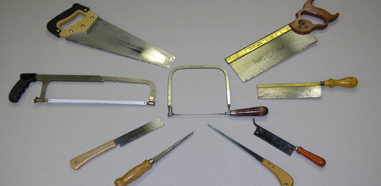

Slide 19
LIST OF MEDICATIONS I WILL NOT PRESCRIBE
PROPOXYPHENE COMPOUNDS
MEPERIDINE
HYDROMORPHONE IR
BUTALBITAL COMPOUNDS
METHADONE
NALBUPHINE
CARISOPRODOL
BUTORPHANOL
PENTAZOCINE
CODEINE

Slide 20
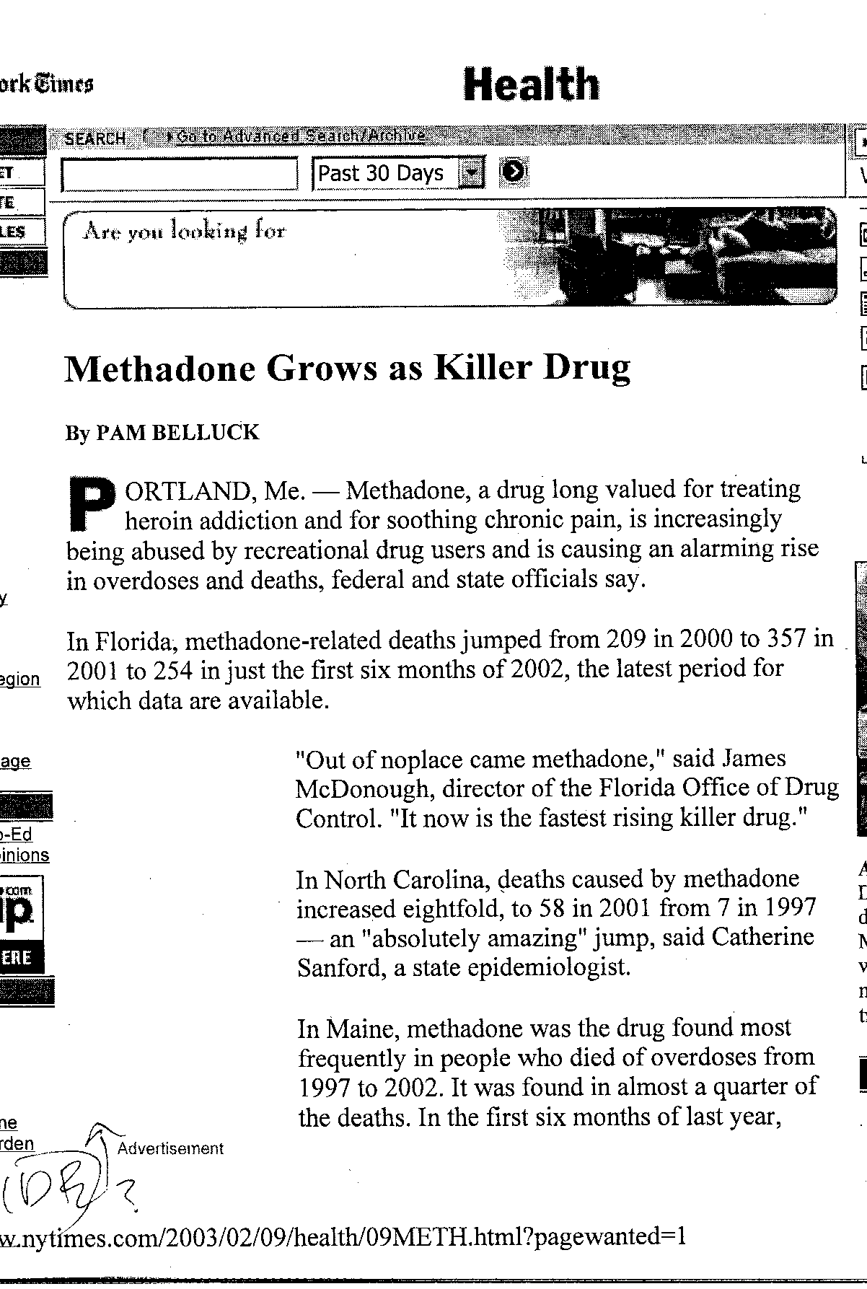

Slide 22
FOOD FOR THOUGHT
WE SHOULD ALL RECOGNIZE THAT THERE
IS A NATIONAL PROBLEM WITH DRUG
USE OF ALL TYPES
CAFFEINE
NICOTINE
ETHANOL

Slide 23
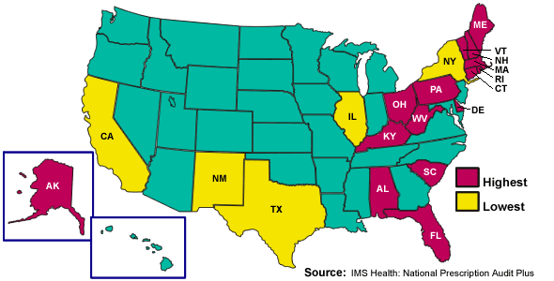
DIVERSION HOTSPOTS

Slide 24
PROHIBITION
EASY SOLUTION
OR
RECIPE FOR DISASTER?

Slide 25
PHYSICIANS FOR RESPONSIBLE OPIOID PRESCRIBING - PROP
PROPOSES MAXIMUM DAILY DOSE
EQUIVALENT OF 100 MG. MORPHINE FOR
NON-CANCER PAIN
MAXIMUM DURATION OF CONTINUOUS
DAILY USE FOR NON-CANCER PAIN OF
90 DAYS

Slide 26
RUSSELL PORTNOY, M.D.
OPIOID THERAPY
FOR CHRONIC NON-MALIGNANT PAIN
Journal of Law, Medicine, and Ethics
24 November, 1996 296-309
“If you insist on regulation, then you are consigning my mother to live in chronic pain.”
Wall Street Journal 17 December, 2012

Slide 27
LYNN WEBSTER, M.D. President of AAPM
“We believe that the adoption of the recommendations in the PROP petition to lower doses or duration would provide a false sense of security for patients and practitioners.”
“In our view, a more effective means to address this problem would be enhanced prescriber education, and adherence to principles of practice, including ongoing monitoring for aberrant behaviors and early signs of addiction.”
Salem News.com Aug. 26, 2012

Slide 28
Steve Passik, P.h.D Professor of Anesthesiology, Vanderbilt University
“I am not pro-opioid, I am anti B.S.”
“In pain management, no exposure of anyone at all means cutting off an avenue to relief for a subset of patients with pain that might otherwise do well. Safe opioid prescribing is the result of assessing the vulnerabilities in highly stressed people and accommodating the delivery of opioid therapy to them. We need to stop blaming the drugs…”
www.reportingonhealth.org/2012/08/30

Slide 29
Pressure to Treat Pain*
JCAHO Regulations
Pain must be monitored and treated appropriately.
Patients have “right” to pain relief.
Patient Advocates and Rights Groups
Demand opioids for benign pain.
Patient’s Bill of Rights in many states.
Litigation for Failure to Treat Pain
$1.5 million largest judgment to date.
18 suites in 11 states pending.
Goal of winning a case in every state.
* The implication being “treating pain”=Opioids

Slide 30
The rock and the hard place
More pressure to prescribe opioids
Lawsuits against physicians for not prescribing
Lawsuits against physicians for prescribing
Criminal charges against physicians for patient diversion and abuse
Individual and Class Action suits against physicians for addiction / dependence
Individual and Class action suits for death (usually accidental overdose)
Individual suits for Accidents under the influence (usually MVA)

Slide 31
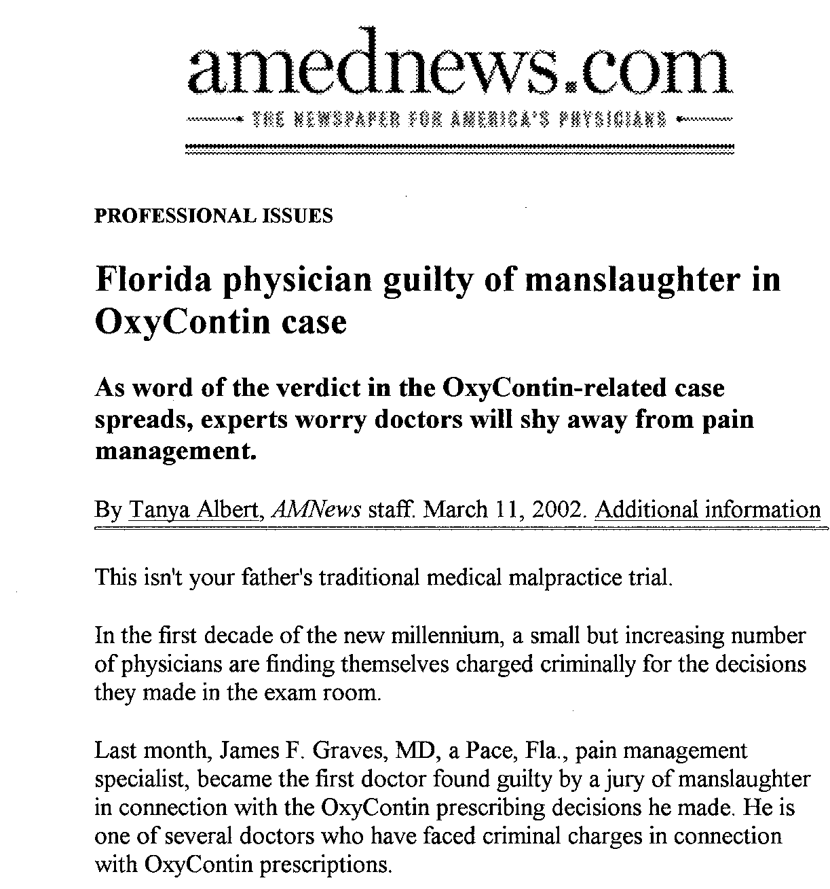

Slide 32
ANESTHESIOLOGIST WINS DISABILITY BENEFITS FOR OPIOID ADDICTION
Julie Colby vs. Union Security Insurance Co.
Exclusion of the risk of drug abuse relapse was ruled an unreasonable interpretation of the insurance plan’s coverage by the federal district court.
Business Insurance 18 January, 2013

Slide 34
Operant Issues
Work Comp 54%
3rd Party Lawsuit 17%
Litigation Total 71%
IME’S 23%

Slide 35
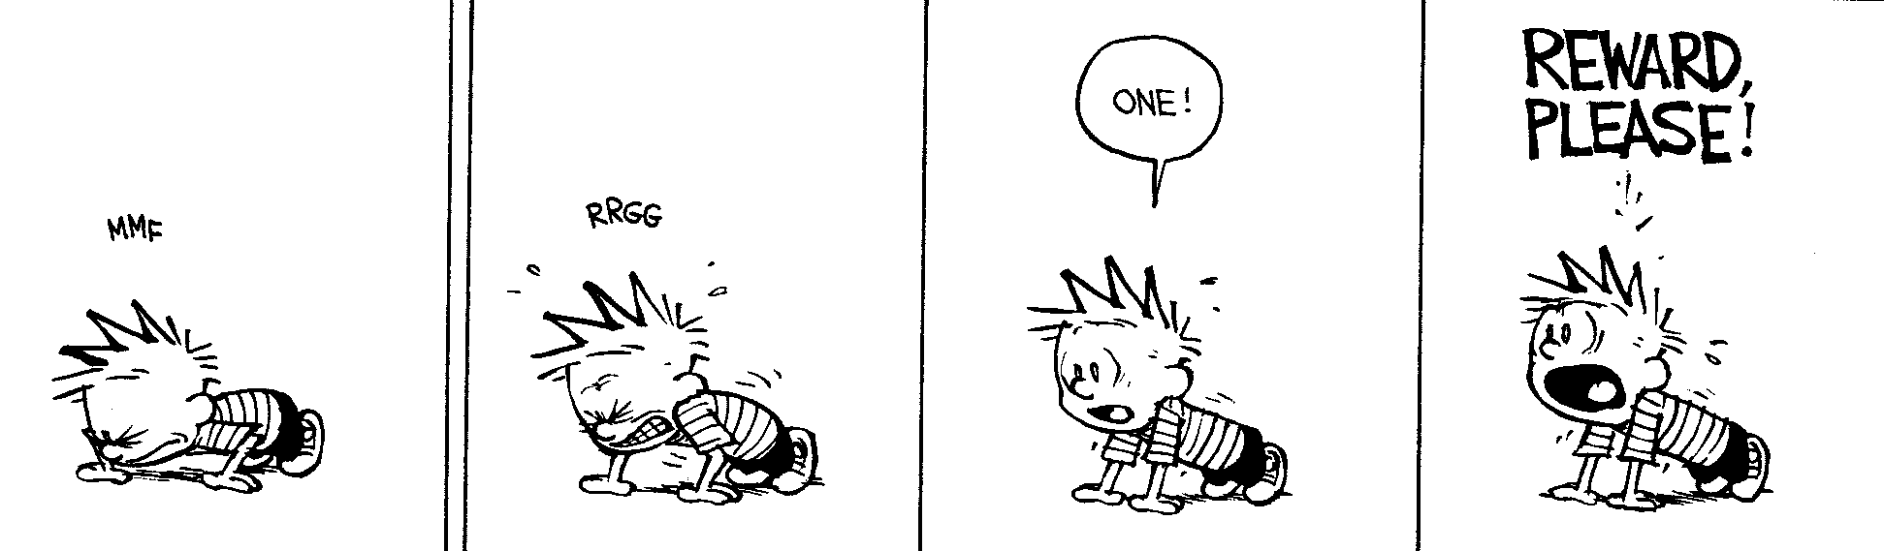
Opioids may be the most powerful operant reward.

Slide 36
INJURED WORKERS AND THE RISK OF NARCOTICS MISUSE
1 in 12 injured workers started on narcotics were still using them 3-6 months later
Only 4-7% of injured workers with long-term narcotics use received psychosocial evaluation and treatment
In the best state studied only 25% received such care
Data based on 300,000 W/C claims in 21 states
Worker’s Compensation Research Institute 2012

Slide 37
EARLY OPIOID PRESCRIPTION AND SUBSEQUENT DISABILITY AMONG WORKERS WITH BACK INJURIES
Opioid use was a risk factor for long-term disability at 1 year
14% (254 of 1843) received work disability compensation at 1 year
Franklin, Stover, Turner, et al.
Spine Jan. 2008 -vol.33 (2) 199-204

Slide 38
Change in Pain Effect of Workers’ Comp
Time: F (3.2, 481) = 11.37, p < .001; Group x Time: F (3.2, 481) = 3.2, p < .02
Gagnon C, Harden N et al Pain Practice 2012

Slide 39
COSTS AND POOR COMPLIANCE WITH BEST PRACTICES
1.4 BILLION DOLLARS SPENT ON NARCOTICS ANNUALLY BY EMPLOYEES AND INSURERS
- 25% OF W/C EXPENSES
ONLY 1 IN 20 PHYSICIANS COMPLIED WITH BEST PRACTICES - RISK ASSESSMENT - SIGNED OPIOID AGREEMENT - OBTAINED RANDOM UDSI
TEXAS, MASSACHUSETTS, AND NEW YORK HAVE ESSENTIALLY BANNED PHYSICIAN DISPENSING BY
GREATLY LIMITING THEIR ABILITY TO DO SO
Jospeh Paduda, President of CompPharma.LLC

Slide 40
OPIODS IN THE WORKPLACE
AMERICANS WITH DISABILITIES ACT AND
DRUG ADDICTION TREATMENT ACT
PASSED CONGRESS IN 2000
Determined opioid addiction as a medical condition
Encourage employers to support employees with opioid dependency

Slide 41
35 year-old Female with CLB on 20mg sustained release oxycodone BID
and several doses of immediate release “rescue” morphine a day.
Each Attempt to decrease opioids fail.
Vocation: School Bus Driver.
RTW Decision?

Slide 42
THE REAL OPIOID DILEMMA
More pressure to prescribe opioids
Lawsuits against physicians for not prescribing
Lawsuits against physicians for prescribing
Criminal charges against physicians for patient diversion and abuse
Individual and Class Action suits against physicians for addiction / dependence
Individual and Class action suits for death (usually accidental overdose)
Individual suits for Accidents under the influence (usually MVA)
35 yo F with CLB on 20mg sustained release oxycodone BIDand several doses of immediate release “rescue” morphine a day.
Each Attempt to ↓ opioids fail.
Vocation: School Bus Driver.
RTW Decision?

Slide 43
WHAT AMERICANS WANT AND EXPECT FROM HEALTH CARE
Cure
Instant gratification
Surgery
Pills
High tech solutions
No effort in their recovery
= Unrealistic goals in pain management

Slide 44
WHAT DOES NOT WORK*
PROHIBITION
NERVE BLOCKS*
PAIN PUMPS*
SPINAL CORD STIMULATORS*
SURGERY*
* FROM A COST/BENEFIT STANDPOINT

Slide 45
WHAT DOES NOT WORK*
NERVE BLOCKS - $25-$100K per year for sometimes endless series of injections
SURGERY- $25-$200K for spinal surgery
IMPLANTS- $45-60K with up to $1000/month
maintenance (replacement in 4 years)
*essentially no evidence at all to support these procedures
Harden – Pain Medicine 2012;(13) 987-988

Slide 46
What doesn’t work cont; Interventional Pain Management*
Nerve Blocks
Nerve Ablations
Spinal Cord Implants
Cortical Simulation
Ketamine Coma
Dead Rooster Comb Injections
*essentially no evidence to
support any of these procedures
Harden -Pain Medicine Vol.13(3) 196-197

Slide 47
WHAT NOW?
DO THE NECESSARY RESEARCH TO ANSWER THE OUTSTANDING QUESTIONS
EDUCATE PHYSICANS AND PATIENTS ABOUT RISKS
RISK MITIGATION STRATEGIES
ESTABLISH A RATIONAL PAIN MANAGEMENT POLICY NATIONALLY
DISCUSS WHO ARE THE MOST APPROPRIATE PROVIDERS FOR CHRONIC PAIN MANAGEMENT

Slide 48
WHAT DOES WORK?
MULTIDISCIPLINARY APPROACH
PSYCHIATRIC SUPPORT
- Cognitive Behavioral Therapy
RATIONAL POLYPHARMACY
WORK HARDENING PROGRAMS
RISK MITIGATION STRATEGIES

Slide 51
Interdisciplinary Team Model
Patient Centered
Team members work together toward a common goal
Make collective therapeutic decisions
Communicate and consult with other team members, facilitated by planned face-to-face meetings
Teams possess a combination of skills that no single individual demonstrates alone
Team is able to achieve more than the sum of the individuals involved
Boon H, et al. BMC Health Services Research. 2004;4:15.; Cummings I. The interdisciplinary team. In: Doyle D, Hanks GW, MacDonald N, editors. Oxford textbook of palliative medicine. Oxford:Oxford University Press, 1998.; Parker GM. Cross-functional teams; working with allies, enemies and other strangers. San Francisco:Jossey-Bass Publishers, 1994;7:31-40.
Notes:
Teams share information and work interdependently. Leadership is task-dependent with tasks defined by the individual patient’s needs. The analogy of the hand is appropriate; individual digits of differing ability, function, and dexterity work together to achieve more than the sum of the individual fingers.
Based on consensus model
Synergy
Creative problem solving
Cummings I. The interdisciplinary team. In: Doyle D, Hanks GW, MacDonald N, editors. Oxford textbook of palliative medicine. Oxford: Oxford University Press, 1998.
Parker GM. Cross-functional teams; working with allies, enemies and other strangers. San Francisco: Jossey-Bass Publishers, 1994;7:31-40.

Slide 52
MULTIDISCIPLINARY PAIN CENTERS
EFFECTIVE IN REDUCING PAIN AND OPIOID USE
DECREASE HEALTH CARE SERVICES
IMPROVE PATIENT FUNCTION
EARLIER RETURN TO WORK
CLOSING DISABILITY CLAIMS
COST EFFECTIVE- ESPECIALLY WITH RECALCITRANT PATIENTS
Drug Benefit Trends 2001; 13(9) 36-38

Slide 53
Physical Therapy
De-emphasizing high tech, passive modalities
Emphasizing low tech, self management and active modalities
Reactivation
Stretch/strengthen
Tens units

Slide 54
Psychotherapy
Cognitive behavioral therapy
Stress management
Coping skills
Relaxation techniques
Guided Imagery
Self hypnosis

Slide 55
WORK HARDENING
EXAMINATION OF OUTCOMES IN DISABLED WORKER POPULATION
SIGNIFICANTLY IMPROVED QUALITY OF LIFE
UNLESS THERE WERE 2 OR MORE INJURIES
MACK,et.al, Disability Medicine 2012,Vol.8 No.1 11-18

Slide 56
SCREENING TOOLS
IDENTIFY ADDICTIVE POTENTIAL
IDENTIFY DEPRESSION –BAD
IDENTIFY PERSONALITY DISORDERS
LIMITS RISK FOR BOTH PATIENT AND PHYSICIAN

Slide 57
RATIONAL POLYPHARMACY
MULTIMODAL THERAPY
USE OF OPIOIDS WITH OTHER MEDICATION CLASSES
MULTIPLE RECEPTOR SITES
1 + 1 + 1 = 5

Slide 58
Chemical Structure of Tricyclic Antidepressants
Tertiary
amines
N
CH₃
C
CH₃
CH₂
CH₂
CH₂
N
CH
CH₂
CH₂
N
CH₃
CH₃
Imipramine
Amitriptyline
Secondary
amines
N
CHCH₂CH₂NHCH₃
CH₂CH₂CH₂NHCH₃
Nortriptyline
Desipramine

Slide 59
Anticonvulsant Drugs and Neuropathic Pain*
First-generation
Carbamazepine^{A}
Divalproex sodium^{B}
Phenytoin^{A}
Valproic acid^{B}
Clonazepam^{B}
Phenobarbitol^{B}
Second-generation
Gabapentin^{A}
Lamotrigine^{A}
Levetiracetam^{B}
Oxcarbazepine^{A}
Tiagabine^{B}
Topiramate^{B}
Zonisamide^{B}
^{A}Published randomized controlled trials.
^{B}Clinical anecdotes and/or published case series.
*Not approved by FDA for this use.

Slide 60
Anticonvulsants/ Neuromodulators
Mechanisms of Action | Drugs
Na⁺ channel blocker | Carbamazepine Lamotrigine Oxcarbazepine | Phenytoin Valproate Zonisamide
Ca⁺⁺ channel blocker | Ethosuximide Oxcarbazepine | Gabapentin Zonisamide
GABA receptors | Barbiturates | Benzodiazepines
GABA metabolism | Vigabatrin Valproate | Tiagabine (Gabapentin)
Glutamate receptors | Carbamazepine Felbamate | Lamotrigine Topiramate
Glutamate metabolism | (Gabapentin)

Slide 61
Topical Medications
Capsaicin
Inconsistent trial results; potential burning upon application
EMLA
May help some patients with allodynia
Clonidine gel
Pilot studies suggest efficacy; controlled trial in progress
Unstudied custom compounds
Doxepin,
other TCAs, gabapentin, opioids, ketamine, guanethidine
Lidocaine/ Diclofenac Topical patches and gels

Slide 62
LONG ACTING OPIATES
ARE MORE EXPENSIVE
LESS PILL COUNT
LESS OFF TIME - REBOUND PAIN AND ANXIETY
LESS DIVERSION POTENTIAL
LESS ABUSE POTENTIAL

Slide 63
NEW FORMULATIONS
IN OPIOID DEPENDENT PATIENTS TAKING NEW FORMULATION OXYCONTIN
ABUSE DECLINED 35.6% TO 12.8%
66% OF SUBJECTS REQUESTED A CHANGE TO ANOTHER MEDICINE
Cicero, NEJM 2012- 367: 187-189

Slide 64
OPIOID SUMMARY
USED TO TREAT MODERATE TO SEVERE PAIN
USED FOR ACUTE AND CHRONIC PAIN SAFE AND EFFECTIVE WHEN USED CORRECTLY CAUSE LESS LONG-TERM DAMAGE TO BODY SYSTEMS THAN FROM OTHER DRUG GROUPS

