Slide 1
National Trends
David J. DePaolo
WorkCompCentral

Slide 2
Agenda
Risk Allocation
State of underwriting
Economic factors
Claims Administration
Frequency & severity
New (and old) risks
Reform across the country
California review

Slide 3
Risk Allocation
State of underwriting
market
profitability
Economic factors
jobs
rates
costs & ratios

Slide 4
Market Share Shift
August Fitch Ratings report:
Top ten continue shifting share of market
Liberty Mutual reducing - still largest overall
AIG/Chartis premium base declined
was leader 5 years ago
Nat’l Indemnity volume doubling in 2012
expansion of regional operations
appetite for trucking, construction, manufacturing

Slide 5
Underwriting
Companies profiting (C/R < 100):
The Chubb Corp
Hartford Fire Group
Nat’l Indemnity Co
Travelers Companies
Companies weak (C/R > 120):
Liberty
AIG
Zurich American
State Comp Ins Fund

Slide 6
Profiting
Fitch notes:
Companies with underwriting profits have expanded premium bases over period
Industry’s aggregate premiums declined by 14% 2007-2012
reflection of recession

Slide 7
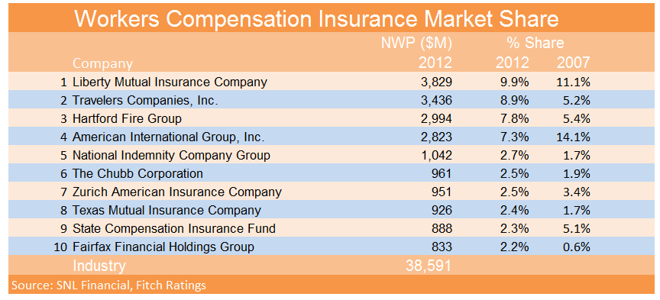

Slide 8
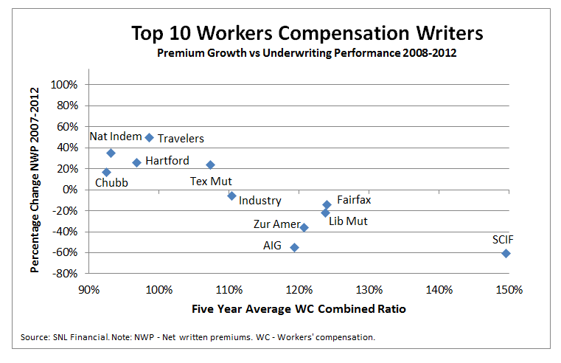

Slide 9
Market Hardening
Commercial Lines in general see premium rate increases
Work Comp most substantial hikes
2nd Q 2013 average 8.3% increase
2011 & 2012 both saw 7% increase
Overall C/R 110%

Slide 10
Challenges
Work comp remains very competitive
still large number of market participants
BUT pricing more collective reaction to profitability than capacity reduction
flattening premiums still risk
Medical
severity stable
medical costs inflation threat
but Patient Protection and Affordable Care Act?
2014 expiration of Terrorism Act

Slide 11
Bucking the Trend
New Hampshire
6.5% decrease in voluntary; 4.2 % in assigned risk
Illinois
4.5% decrease in voluntary rates
West Virginia
8.8% decrease in voluntary; 8.5% in residual
Arkansas
7.4% decrease in loss costs; 6.7% in assigned risk
South Dakota
3.2% voluntary market (assigned risk increase 0.3)
Montana
5.4% decrease in loss costs
Kentucky
7.9% decrease in loss costs

Slide 12
Texas
Independent Insurance Agents of Texas:
2012 - 13.1 % increase from 2011
2.7 percent increase from 2010 to 2011
Premiums had declined for five straight years prior to 2010.
2012 loss ratio 47.7 percent
compare 2011 - 43.3 percent
compare national loss ratio - 67.9 percent
Texas Mutual
37.1 percent market share in 2012
33.8 percent in 2011
premium increase 24.2 % over 2011.

Slide 13
Economy & Financials
National jobless rate slowly improving
Between 7.6-7.4% nationally (August)
CA job growth fastest
high wage, low risk jobs
still at 8.5% (July, adjusted)
TX second biggest gain
6.5% jobless rate
10.8M working (July)
Job growth in health care, tech
construction picking up
manufacturing anemic - outsourced to technology

Slide 14
Unemployment
US DOL:
162,000 new jobs in Jul, fewest since Mar
50%+ in the restaurant and retail sectors
both pay well under $20 an hour on average
unemployment rate 7.4%
lowest level since December 2008
BUT job market still too weak to draw back workers who have dropped out of the labor force
6.6 million workers say they want a job but don't count as unemployed because they aren't actively looking

Slide 15
Low Wage Sector
Proliferation of low-wage jobs
Amazon.com Inc. facility in Chattanooga, Tenn.
adding more than 5,000 full-time jobs in its distribution centers across the country
Many of the jobs pay $11 an hour or less but have benefits

Slide 16
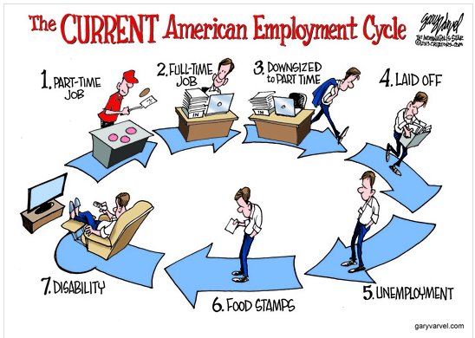

Slide 17
Economy & Financials
Payroll & premiums NCCI:
7.4% increase to $36.3B
first since 2005
follows 29% decline 2005-2010
2 reasons:
increase in carrier payroll estimates
additional premium from audits
CA WCIRB:
construction still burden on premium
pressure on rates
carriers holding down premium

Slide 18
Financial Markets
July:
The DJIA up 30.34 points to 15658.36
30th new high this year alone.
Bond prices up
yield on 10-year Treasury note falling to 2.601%.
"In an economy that grows less than 2% we don't have a lot of hiring needs because our productivity exceeds that"
Alexander Cutler, chief executive of Eaton Corp.

Slide 19
Bonds
Martin Feldstein - prof economics Harvard
long term interest rates rise = 10 year Treasuries lose more from decline in value of bond than gain in difference between rate & short term funds
inflation of only 2% outpacing real rate on 10 year bonds

Slide 20
Combined Ratios
NCCI:
2011 projected - 115
2010 = 115; 2009 = 110; 2007 & 08 = 101
WCIRB:
2011 - 122
2010 = 117; 2009 = 117

Slide 21
Loss Costs
NCCI:
2011 loss ratio 71%
no change from 2010
loss adjustment unchanged - 16%
WCIRB:
2011 medical losses = $4.4B; 60% of total payments
2010 $4.3B; 2009 $4.2B
cost containment = $384M
2010 = $356M; $197M 2005 (94% increase!)

Slide 22
Residual Markets
NCCI:
6 years of decline
up 12% first 3 Qs of 2011 compared to 2010
new assigned premium bound up 27%
more small employers?
more high risk business?

Slide 23
Residual vs. State Fund
NCCI
first increase in premium since 2004
increase of 13%
by 2Q 2012 up 50%
factors: new employers & increase in construction
industrial, manufacturing
CA SCIF
$1B premium; 12.9% market
no change in rates
moribund CA construction?

Slide 24
NASI - 8/2013
National Academy of Social Insurance:
Cost to employers 2011 $77.1B
up 7.1% from 2010
“first increase in costs since 2005”
relative to $100/wages, $1.27
$1.24 in 2010
Covered workers 1.1% higher than 2010
125.8 million workers
Covered wages up 3.95%
$6.0 trillion in wages in 2011

Slide 25
Immigration Reform
Underwriting
increased payroll?
Claims Administration
increased risk?
agricultural, construction, food service
language, cultural boundaries to safety

Slide 26
Claims Administration
Frequency & severity
Drugs & Dr. dispensing
ACA
Miscellaneous
same sex marriage
nanomaterials
silica

Slide 27
Frequency & Severity
NCCI:
3% jump 2010
same rate as wages
lost time frequency flat;
average cost up 3.2%;
construction recession =
downward pressure frequency per payroll
upward pressure frequency per premium

Slide 28
Frequency & Severity
CA WCIRB
9.1% jump 2010; steady since (i.e. not deflating)
2.1% increase indemnity
6% increase medical

Slide 29
Incidence Rates
BLS 2010 stats:
Incidence rate 3.5/100 FTE
3.1 M nonfatal workplace injuries/illnesses
1/2 involved days away from work (1.8)
manufacturing only sector with increase: 4.4
automation/technology/training risks?
health care only sector with decrease in rate AND increase in affected payroll

Slide 30
NASI - benefits
Total benefits paid - $60.2 billion
3.5% increase over 2010
Medical payments - $29.9 billion
4.5% increase over 2010
Cash benefits - $30.3 billion
2.6% increase over 2010

Slide 31
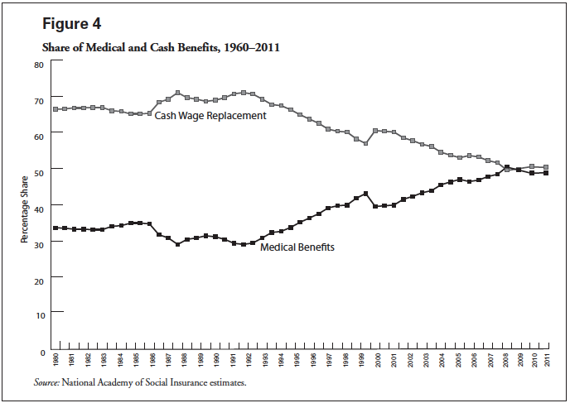
NASI - indemnity vs medical

Slide 32
Drugs
How bad is it?
UT judge sentenced 8/2013 for acting as “mule” to dealer for Oxycodone
presided over misdemeanor drug cases
used Oxycodone for neck pain
admitted knowing dealer would illegally distribute
payment was keeping some of the pills
AP & Salt Lake City Tribune

Slide 33
Drugs & Opioids - Federal
US FDA mandate manufacturers to offer training beginning 3/01/2013
3 hr. CME
manufacturers create programs, FDA approval
Goal: 25% of 320,000 who prescribe in first year, 50% by second year and 60% by third
Rx companies to publish guides
Recommends patient agreements
Recommends full history inc. family drug abuse issues

Slide 34
Drugs & Opioids - States
CA: decline in Rx of opioids:
Sch. II: from 6.7% of all Rx 2Q, 2011 to 5% 3Q and 4.9% 4Q; from 20.8% all Rx payments in 2Q to 17.7% in 4Q
Sch. III: from 19.9% of all Rx 2Q, 2011 to 18.7% 4Q; from 10.4% all Rx payments 2Q to 9.7% (CWCI)
IAIABC model law
NY: Internet System for Tracking Over-prescribing
OK: mandates opioid reporting

Slide 35
Drugs & Opioids - States
WA: 2007 Guidelines
191% increase in Sch. II 1996-2006 (66,544)
decreased to 44,209 in 2010
Sch. III = 93,550 in 1999
decreased to 52,499 in 2010
FL: HB 7095 - physician ban on dispensing Sch. II & III drugs
CO: 2012 Guidelines
screen for HX of substance abuse
pain specialist consultation
treatment contract

Slide 36
Opioids - SCIF strategy
4,800 MPN docs 2011
Enrollment plan
Dr agrees no compound drugs
No opioids longer than 60 days w/o prior approval
response to CWCI study
3% of physicians responsible for ½ Sch II
accounted for 55% of Sch II Rx
and 65% of associated costs

Slide 37
OxyContin Exposed
LA Times investigation
Purdue Pharma = $27 billion since 1996
compiled a database 1800 doctors suspected of recklessly prescribing its pills to addicts and drug dealers
“the company created the database to steer its sales representatives away from risky doctors”

Slide 38
Repackaged Drugs
AIA: only MA, NY & TX explicitly prohibit DR dispensing.
States that limit reimbursement of repackaged Rx to what a pharmacy paid: AZ, CA, CT, GA, MS, TN, SC
FL: failure in 2010, 2011, 2012
2013: 112.5% AWP + $8 dispensing fee
BUT eliminated law allowing payment at lowest price for which contracted in IW geographic region...

Slide 39
Physician dispensing
WCRI:
CA - limit no effect on dispensing habits, but costs decrease
FL - Dr dispensed drugs 60-300% more than pharmacy
GA - cap on repackaged Rx by regulation 4/11
IL - 43% of ALL drugs dispensed from DRs, collecting 63% of all $$ spent on prescriptions (2010-11)
Feds - reimbursed based on the AWP of the medications as identified by the original manufacturer’s NDC

Slide 40
Dr. Rx Profits
After GA cap & ban on self AWP
NCCI & WCRI: pill price drop 22%-36%
STILL 20%-40% higher than pharmacies
WCRI:
Drs less likely to Rx over-the-counter drugs
Rx’d drugs with higher price more often
GA: Dr. Rx share dropped from 35% to 28%
“didn’t stop … just eliminated some of their margin”

Slide 41
Hardware Pass Through
CA whistleblower complaint alleges:
counterfeit hardware
payola & kickbacks to docs
cappers & runners
mark-ups of 500% +
fraudulent documentation
shell companies
Perps moved to other states...

Slide 42
Healthcare Reform
Medicare
fee schedules - unknown effect on states tied to MC
CA reform - RVRBS = shift away from specialists to general practitioners
will it cause contraction in available DRs?

Slide 43
Healthcare Reform
Non-discrimination:
Unknown effect
cost shift AWAY from WC?
absorption of long tail medical?
treatment outside of WC?
subrogation litigation increase?

Slide 44
Healthcare Reform
Deloitte - 10% dropping coverage
1 in 3 may if:
law requires more than current;
high-cost plan tax takes effect 2018; or
penalties cost less than coverage
difference in employer size:
1,000+ less than 2%
50-100 most likely @ 13%
McKinsey - 30% dropping coverage
Congressional Budget Office - 7%
http://online.wsj.com/article/SB10000872396390443437504577545770682810842.html

Slide 45
ACA advantage?
Use comp settlement premium to help IW purchase health exchange plan
Health outcomes incentives
if works - will migrate to comp?
national standards for comparison
Electronic Health Records

Slide 46
Nanomaterials
Charlie Kingdollar, VP emerging issues unit General Re Corp.
“one of the most important, and possibly the most ignored, emerging issues”
Swiss Re: 15% of all materials manufactured in the U.S. will have some type of nanomaterial in them by 2015.
NIOSH recommends exposure limit for nano-titanium dioxide
increased use of nanomaterials in the production of industrial and consumer products, more workers are at an increased risk of exposure.

Slide 47
Another asbestos?
Reinsurers such as General Re, Swiss Re and Lloyd’s, all of which have long been exposed to costly asbestos liabilities, have been pushing insurance carriers to stay on top of the regulation, science and insurance implications of nanotechnology – fearing it could evolve into another asbestos-like problem in the future.

Slide 48
Silica
OSHA proposal: cut permissible exposure limit of crystalline silica in half
Risk of respiratory and kidney disease
2 different standards: one for general industries and maritime employers, and a second standard for the construction industry.
Would also require employers to train exposed workers, limit workers' access to areas with the dust, provide respirators to workers faced with unlimited silica exposure, perform medical surveillance and use a variety of proven dust-control methods

Slide 49
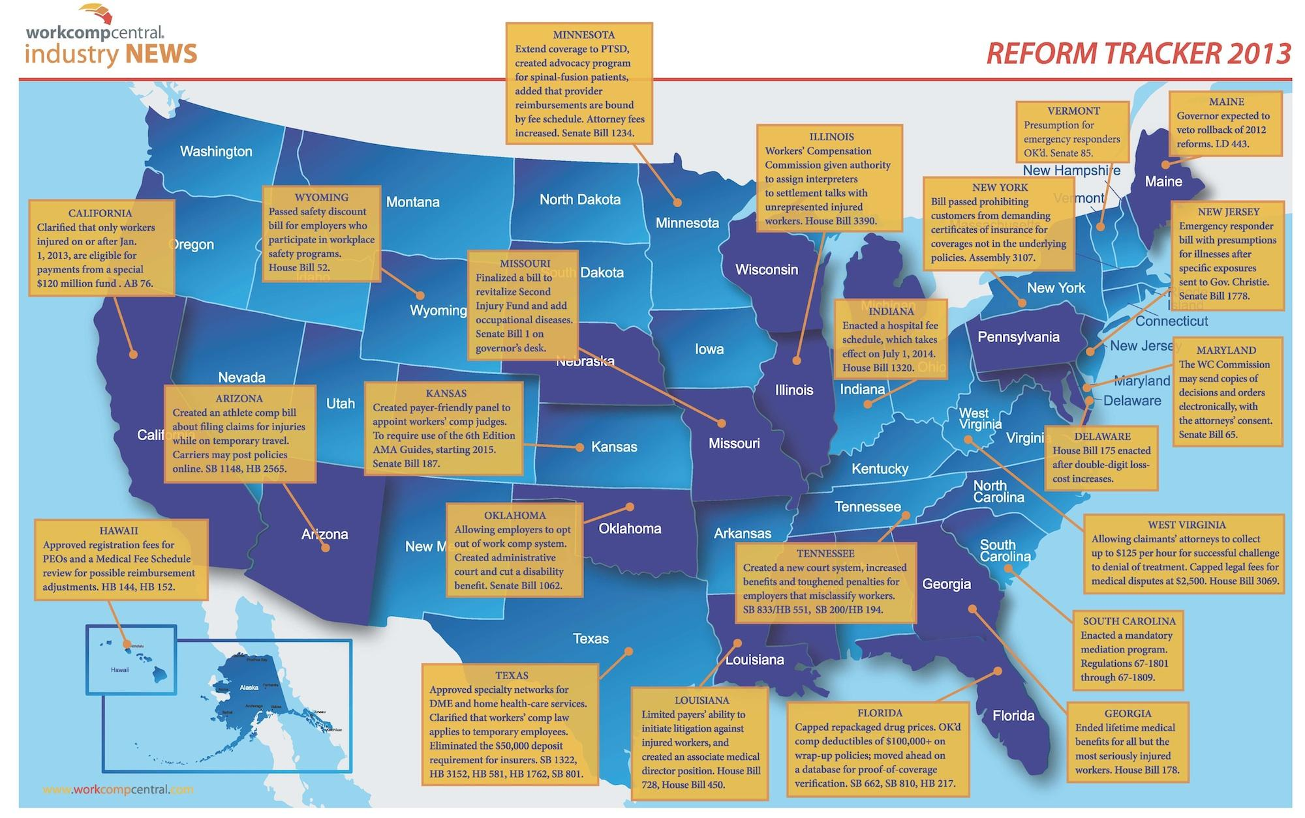
Reform States

Slide 50
Oklahoma
Opt out
effective 2/14/14 for injuries 1/1/14
written benefit plan serves as replacement to WC
employer full medical control
still no negligence action vs. employer
disputes go through WC process
backed by guarantee fund
Administrative dispute resolution
previous civil courts
settlement offer attorney fee limit - 30% difference between written offer and award

Slide 51
Delaware
suspends for 2 years medical fee inflation
lowers inflation index on hospitals
pharmaceutical cost controls
statute / limitations appealing UR decisions
broader fee schedule
return-to-work considered in workplace safety credits

Slide 52
Florida
Physician dispensing
112.5% average wholesale price + $8 dispensing fee
Unconstitutionality of 104 week cap (Westphal)
Unconstitutionality of prohibition against hiring attorney for motions for costs
cases pending Supreme Court

Slide 53
Georgia
Non-catastrophic medical capped at 400 weeks from DOI
Increased TPD to $350/week, 350 weeks from DOI
Increased TTD to $525/week, 400 weeks
Bona-fide RTW commitment if modified duty offered
full work shift or 8 hours, whichever longer
If IW unable then full benefits and ER to prove otherwise
if IW does not complete full shift, ER can suspend

Slide 54
Indiana
Hospital fees 200% of Medicare
Caps on repackaged drugs, surgical implants
Benefits:
AWW increase of 20% over 3 years
PPD increase of 25% (gradations based on ratings)

Slide 55
Minnesota
Recognizing stand alone psyche if not product of good faith personnel action
Cap on job development benefit
Restructure of attorney fees
PD COLA + increase in max rate
Narcotics contracts

Slide 56
Missouri
Second Injury Fund:
1/1/14 - PPD claims excluded from fund
limited to PTD claims
employer assessments increased 3% net premiums
expires 12/2021
Occ disease exclusive remedy; extra benefits
200% SAWW for 100 weeks
special mesothelioma benefit: 300%, 212 weeks
no subrogation
Special Meso fund - employer must opt in
failure defeats exclusive remedy
Police psyche = occupational disease

Slide 57
Tennessee
Administrative dispute resolution
Strict statutory construction of WC Act
Eliminated RTW multipliers in PD
strictly based on impairment rating
50% AOE/COE causation standard
Medical advisory committee to develop treatment guidelines

Slide 58
Illinois
New law that will punish employers who misclassify their workers with fines of $1,000 for first offenders, and $2,000 for second offenders.
Employees of offending businesses will receive 10% of the fines received, with the rest going to the state Department of Labor.
Execs of offending businesses personally liable, too.

Slide 59
No Carolina
HB 74 - Regulatory Reform Act of 2013
no civil service protection for 20 WCJs
WCJs tasked with administering eugenics compensation program
removed Industrial Commission's administrator, executive secretary and deputy commissioners from the state Personnel Act
That statute allows workers with two or more years of service with the state to be fired only in instances of just cause

Slide 60
Texas & Ratings
DWC rule - hearing officers can not consider impairment ratings that are not based on the date of MMI
inadmissible
must be on DWC form 069
regs controversial because issued while TX Sup Ct case pending (thus far in 2 cases Sup Crt ruling against DWC…)

Slide 61
California
SB 863 reform
indemnity
treatment
review
liens
fee schedules
self-insurance
premiums
ratios
litigation
costs

Slide 62
SB 863 - indemnity
PD increase
elimination of +/- 15% RTW provision
elimination of DFEC adjustment
elimination of certain “add-ons”
SJDB
$6000
$1000 computer expenses
$500 miscellaneous

Slide 63
SB 863 & treatment
Chiro can’t be PTP after 24 visits
Home health care tightened
MPN management tightened

Slide 64
SB 863 - medical review
IMR process instituted
EE may request after UR denial
time limits on responding, supplying records
anonymous & binding
exceptions
IBR
similar to IMR except medical treatment billing

Slide 65
SB 863 - liens
filing & activation fees
certain provider types excluded
must provide proof at hearing or dismissed
confusion/ambiguity on application
may be reimbursed if written demand criteria met
1/1/2014 armageddon date
no fee, lien dismissed “matter of law”
subject of federal injunctive lawsuit
taking of property
new statute of limitations
no assignments
unless originator ceased business

Slide 66
SB 863 - interpreters; copy
new interpreter qualifications, certification
different based on hearing, deposition, medical treatment, medical-legal
interpreter fee schedule
copy service fee schedule

Slide 67
SB 863 - self insurance
new security deposit requirement
based on actuarial each 12/31
= to projected losses, net of excess adjustment expense and unallocated loss adjustment
eliminates:
125% of estimated future liability
10% admin/legal add-on
$220,000 minimum
new rules for failure to pay, failure to fund
PEOs not authorized to self insure

Slide 68
California premiums
2012 written premium $12.5 billion
15.7% higher than the $10.8 billion collected in 2011
42% higher than the $8.8 billion collected in 2009
highest since 2007
due to rate increase more than payroll growth.
1Q 2013 written premium about $3.9 billion
18% more than what was reported 1Q 2012.
average rate 1Q 2013 = $2.83 /$100 payroll
$2.57 charged in the last 6 months of 2012 (10% up)
17.4% higher than first half of 2012 ($2.41)
Avg charged rates up 34.8% from 2009 ($2.10)
2009 lowest since 1995

Slide 69
California - ratios
combined ratio 117% in accident year 2012
compared: 137% in 2011; 138% in 2010; 136% in 2009
2012 calendar year loss ratio 115%
compare: 122% in 2011, 117% in 2010 and 116% in 2009

Slide 70
California - litigation
Following the 2004 reform (SB 899):
defense fees from $368M in 2003 to $642m in 2006
applicant attorneys essentially remained flat.
2012 legal fees are double what they were in 2002 for both defense and applicant.
Compare to the Consumer Price Index rate of inflation - $100 in 2002 would only be $126.56 in 2012.

Slide 71
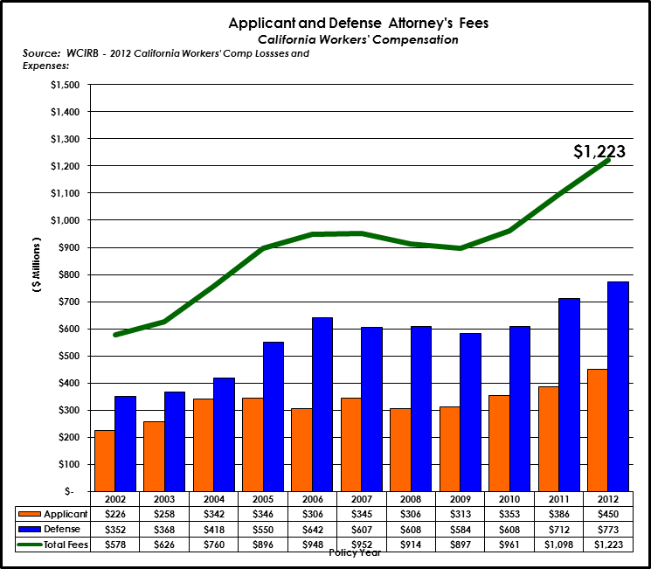

Slide 72
RVRBS
CWCI: will increase medical $250 million
Rand said $104 million
CWCI says Rand didn’t account for cumulative costs because DWC’s methodology for inflation more generous than Medicare
“If Medicare’s update factors continue to be lower than those proposed by the DWC, over time, there would be a compounding effect and the total allowable fees for workers’ compensation physician services would become an increasingly higher multiple of the total allowable fees for those same services under Medicare.”

Slide 73
CA Costs Stabilizing?
CWCI August
Medical:
AY 2010-2012, avg. med decrease 1% 3 months post injury; 3% 6 months post
Indemnity:
AY 2010-2011, decrease 5.2% 6 months post
AY 2011-2012, decrease 2.2%
possible trend reflection?
or economic reflection?

Slide 74
Conclusions
Rates going up, premiums growing
stability uncertain
ratios perilous
Medical tempering
still subject to frequency, severity pressure
drug, hardware outliers
Medicare instability
ACA uncertainty
Opt-out watch
CA clean up
savings in jeopardy

Slide 75
The End
david@workcompcentral.com
805-484-0333

