Slide 1

South Carolina Workers’ Compensation Education Association – May 2013
BMW Manufacturing Company
$afety $aves – implementing a safety policy
Andrew Walker, CIH, CSP, MBA

Slide 2
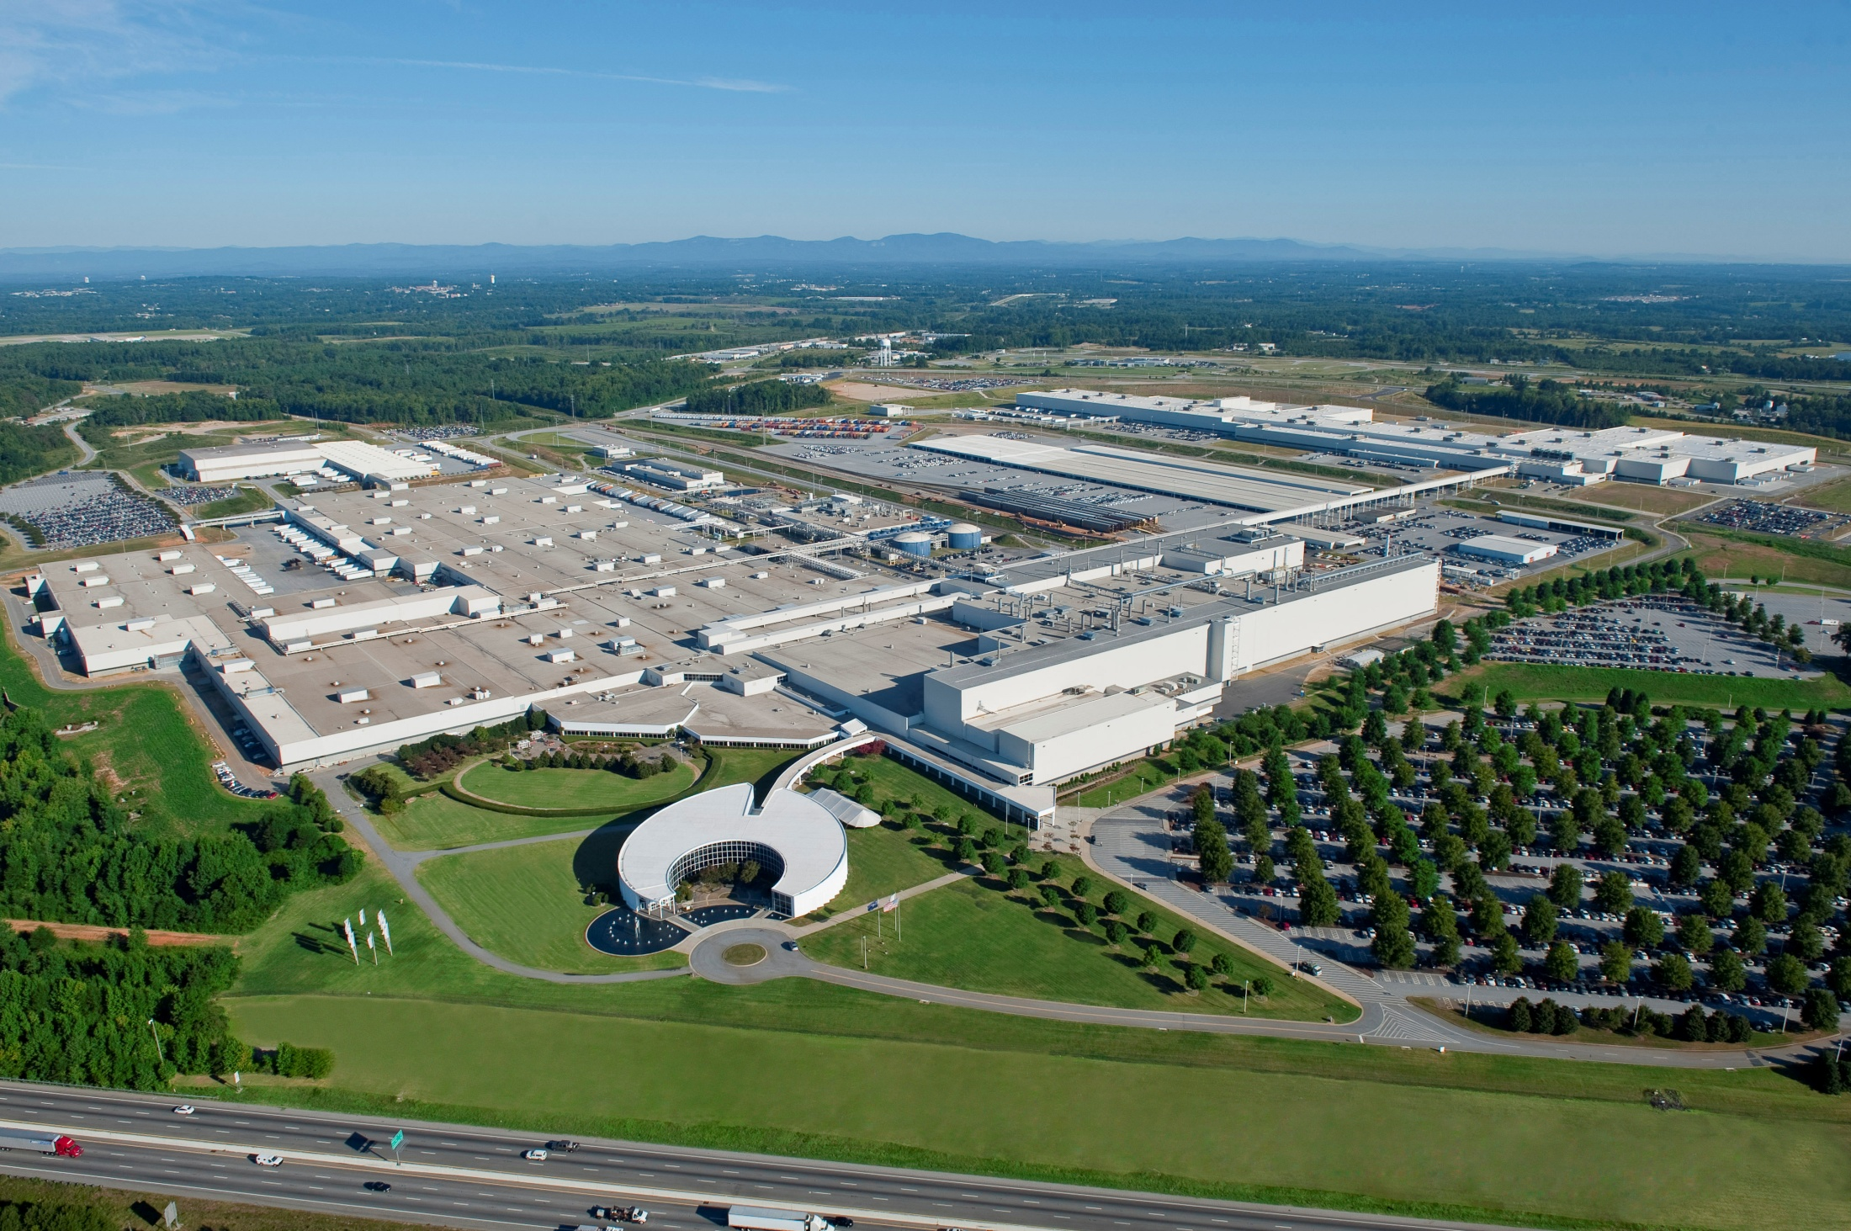

BMW Manufacturing company
Who we are
70% Exported to 130 Markets
4.5 Million Square Feet
7,500 Jobs Onsite
$5 Billion
Investment

Slide 3

BMW Manufacturing company
what we do
Support worldwide demand for X3, X5, and X6 (and their variants).
Current Production Volume is ~315K units.

Slide 4
Bmw manufacturing company
Management house
Associate Involvement/Engagement
Planning
Training
Policy Statement
Communications
Targets
Management Commitment/Involvement

Slide 5
Associate Involvement/Engagement
Associate Involvement
Benefits and Opportunities
Planning
Training
Policy Statement
Targets
Communications
Management Commitment/Involvement
Associate Involvement/Engagement provides the “roof/protection” for the entire Management House.
Opportunities include:
  Safety Walkthroughs/Inspections/Audits/Observations
  Risk Assessments
  Kaizan Events/Continuous Improvement Projects
  Safety Representatives
  Safety Committees/Focus Groups
  Safety/Health Perception Surveys
Empowering/engaging the hourly workforce is critical for long, term sustained improvements.
Associate Involvement Commitment

Slide 6
Associate Involvement/Engagement
Planning
Sustainability model
Planning
Training
Policy Statement
Targets
Communications
Management Commitment/Involvement
BMW MC employs a cradle-to-grave approach with our associates:
  Pre-placement activities
  Increased Automation
  Ergonomics/Safety Systems
  Job Rotations
  Early Intervention Process
  Aggressive Claims Management

Slide 7
Associate Involvement/Engagement
Planning
Hierarchy of controls
Planning
Training
Policy Statement
Targets
Communications
Management Commitment/Involvement
Product, Process, Logistics Improvements
Lift Assists, Tilt, Floor Conveyors
Kevlar, Safety Glasses, Hearing Protection
Job Rotation
EIP, MoveSmart, Annual Safety Training
Safety Expectations, Safety Absolutes
Elimination of Hazard Preferred
Engineering
Personal Protective Equipment
Administrative Controls
Education
Enforcement Less Desired

Slide 8
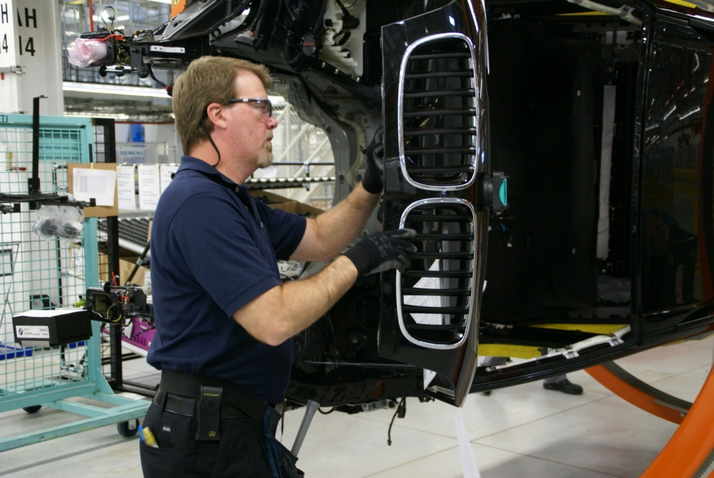
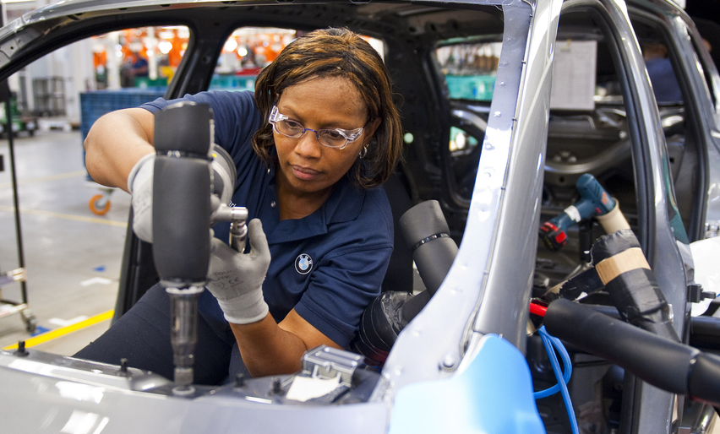
Associate Involvement/Engagement
Planning
Pre-placement activities
Planning
Training
Policy Statement
Targets
Communications
Management Commitment/Involvement
All personnel are required to satisfy pre-placement activities, including:
  Physical evaluation
  Essential Functions Testing
  Drug Screening

Slide 9
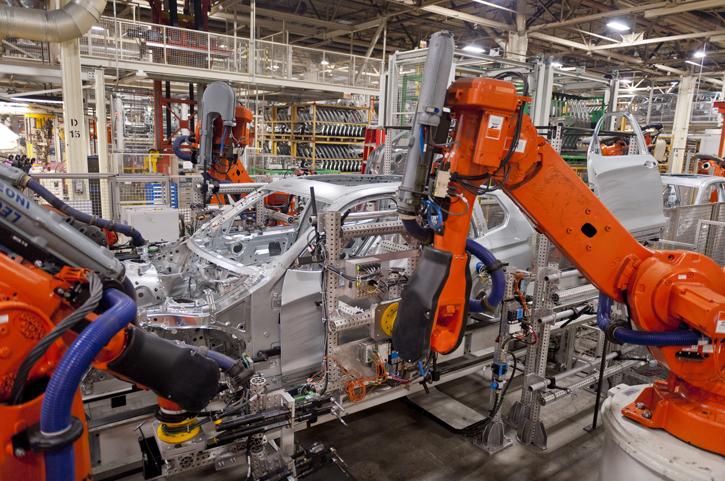
Associate Involvement/Engagement
Planning
Product, process, packaging
Planning
Training
Policy Statement
Targets
Communications
Management Commitment/Involvement
Commit significant resources into planning activities with focus on:
  Product
  Process
  Packaging
With each vehicle introduction/model change, opportunity to “learn” for experiences, identify issues, and eliminate/minimize risk of injury.
Increased automation in all areas of the facility – reduces operating costs and ergonomics stressors.

Slide 10
Associate Involvement/Engagement
training
Safety/health Training
Planning
Training
Policy Statement
Targets
Communications
Management Commitment/Involvement
Training reinforces organization’s commitment and outlines expectations.
  New Associate Orientation
    Communicates basic requirements
    Establishes expectations
    Reinforces organization’s culture/norms
  Annual Refresher Training
    Communicates changes
    Reinforces commitment, expectations, culture
  Regulatory Training
Must include tracking, transparency, accountability for non-adherence (tie to a target).

Slide 11
Associate Involvement/Engagement
training
Early intervention process
Planning
Training
Policy Statement
Targets
Communications
Management Commitment/Involvement
EIP process represents “paradigm shift from breakdown model to healthy associate model.
Overall, 94% success rate of the 1660 associates who participated in the process in 2012.
our primary focus remains on identification/resolution of ergonomics/safety issues.

Slide 12
Associate Involvement/Engagement
Policy Statement
Vision and Mission
Planning
Training
Policy Statement
Targets
Communications
Management Commitment/Involvement
Safety/Health Vision and Mission
Vision
BMW Manufacturing will be the industry leader in occupational safety and health.
Mission
To sustainably build the ultimate driving machine in a healthy and safe environment with safe processes and safe behaviors.
PA-63 2/6/13

Slide 13
Associate Involvement/Engagement
Policy Statement
Policy statement
Planning
Training
Policy Statement
Targets
Communications
Safety/Health Policy Statement
We at BMW Manufacturing strive to provide a healthy and safe working environment.
In order to continually improve our performance:
  All levels of management are responsible and accountable for providing the resources needed to ensure a safe workplace and safe work practice.
  Management must ensure all associates are responsible and accountable for working safely.
  Management will establish objectives and drive change through targets.
  We will meet or exceed legal and internal requirements.
  We will regularly measure and communicate our progress to all levels of the organization.
Serves as the key pillar of the management house.
Establishes accountability and that everyone “owns” safety.
Management Commitment/Involvement
PA-63 2/6/13

Slide 14
Associate Involvement/Engagement
Policy Statement
Safety Expectations/Absolutes
Planning
Training
Policy Statement
Targets
Communications
Management Commitment/Involvement
Safety Expectations
Reporting of injuries
Following process sheets
Working in designated process areas
Wearing PPE
Walking in designated pedestrian aisles and looking before cross logistics aisle
Safety Absolutes
Must communicate expectations and consequences for failing to comply.
PA-63 2/6/13

Slide 15
Associate Involvement/Engagement
Communications
Daily communications
Planning
Training
Policy Statement
Targets
Communications
Management Commitment/Involvement
All meetings start with “Safety”
Weekly Senior Management Meeting
Monthly Management Meeting
Safety Alerts for widespread issues
We are creatures of habit – the more we hear things, the more second nature they become, and more they become a habit/value.
PA-63 2/6/13

Slide 16
Associate Involvement/Engagement
Targets
osha incident rate – long run trend
Planning
Training
Policy Statement
Targets
Communications
Management Commitment/Involvement
What gets tracked and gets measured, gets accomplished.
BMW MC’s Primary Key Performance Indicators include :
  Safety
  Quality
  Cost
  Delivery

Slide 17
Associate Involvement/Engagement
Targets
Development of Targets
Planning
Training
Policy Statement
Targets
Communications
Management Commitment/Involvement
Use a blend of leading/lagging indicators
  Plan to Actual Safety Walkthroughs Completed
  Time to Close Improvement Items
  Plant to Actual Kaizan/Improvement Activities Completed
  Timely Closure of Accident Investigations
  Plant to Actual Risk Assessments Completed
  Identified Opportunity Areas from Associate Surveys
  OSHA Incident Rate
  Lost Workday/Case Rate
  Workers’ Compensation Costs
Use balanced scorecard or weighted scorecard to generate overall score
Must be reinforced with personal accountability – impact personal performance reviews and/or bonus.
Leading Indicators
Lagging
Indicators

Slide 18
Associate Involvement/Engagement
Management Commitment/Involvement
Development of activities
Planning
Training
Policy Statement
Targets
Communications
Management Commitment/Involvement
  Safety Target Development/Breakdown
  Senior Management Reviews
  Participation in Safety Walkthroughs
  Inclusion in All Associate Meetings/Roundtables
Must move beyond the “talk-the-talk” to a “walk-the-walk” approach.
Visible Participatory Leadership is critical to the entire process.

Slide 19

Associate Involvement/Engagement
Bmw manufacturing company
Summary
Planning
Training
Policy Statement
Targets
Communications
Management Commitment/Involvement
There is a balance of resources (time, talent, treasures) within an organization.
The target represents the “sweet spot” between quality, cost, and safety.
This “sweet spot” provides the greatest profit potential for an organization.
QUALITY
COST
SAFETY/ERGONOMICS

