Slide 1
Workers Compensation
Getting Involved in Your Claims
The Employer’s Perspective
Lucinda Fountain Asst. Mgr
Honda of South Carolina Mfg., Inc.

Slide 2
Reporting a Claim

Slide 3
Professional Reporting
The employer is responsible for initiating a claim with a timely first report of injury, providing details of the accident and verifying the injured worker's account of the incident or illness.

Slide 4
When to Report a Claim for a Work-related Injury
When the employee requires or will require medical treatment beyond the ordinary first aid;
When the injury has caused, or will cause the injured employee loss time from regular duties.

Slide 5
Policies and Procedures

Slide 6
Policies and Procedures
An employer must have documented procedures on reporting work related injuries
In-house Safety Policy
Drug Screening Policy
Employee Interaction (Covers the Employer’s Responsibility to the Workers Comp Claim)
Injury and Treatment Procedure
First Notice of Injury
OSHA Record Keeping
Return to Work Procedure
The procedure must be addressed in the company’s employee handbook
Procedures must be a vital part of a new-hire’s review during a new-hire’s orientation

Slide 7
Investigation

Slide 8
When to Investigate & Why
Immediately !
Facts are fresh
Little time for excuses
No influence by witnesses
Physical conditions are the same
People are available

Slide 9
Investigation Details
Accident Description
Detail, Detail, Detail !
Identify
Who? What ? Where? When, Why and How?
Nature of associates job duties
What happened
Preceding events
Objects involved
People involved
Witnesses

Slide 10
Document, Document, Document!
How?
How many?
Who?
What?
Where?
When?
Why?
Plus
Plus

Slide 11
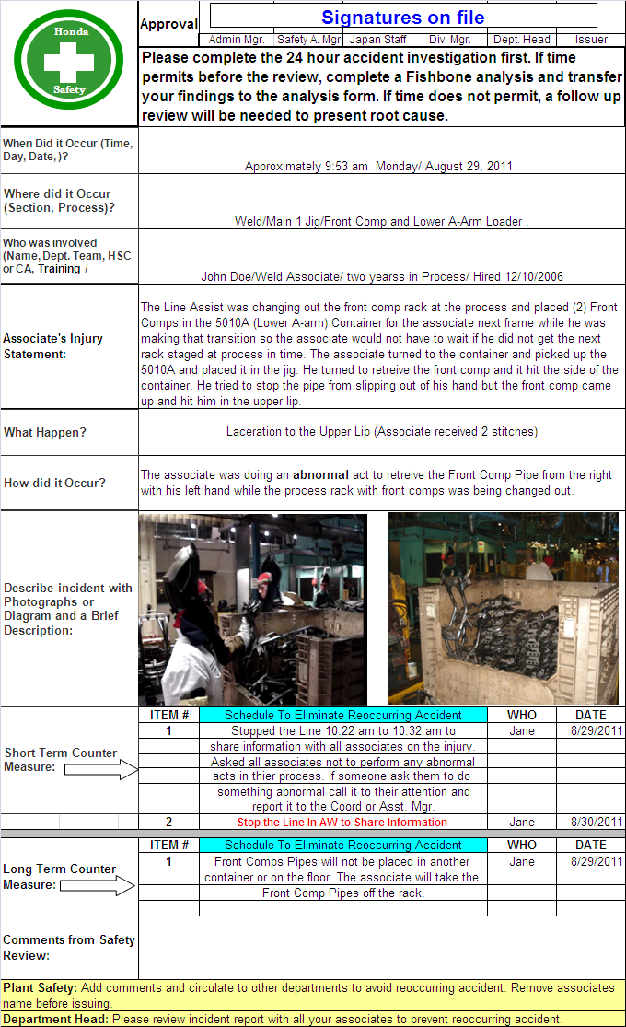
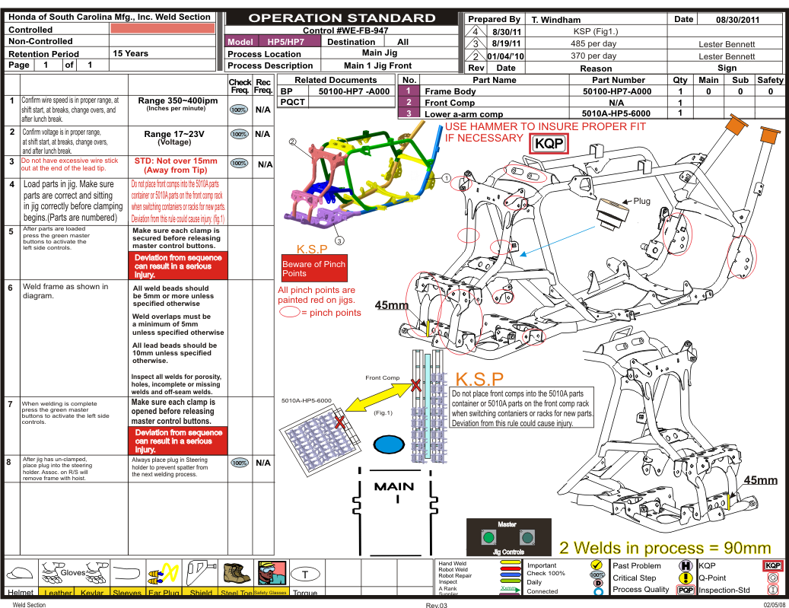
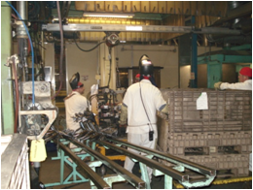
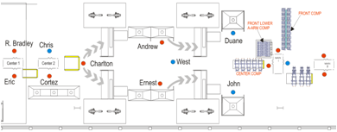
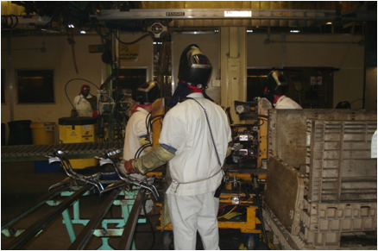
Internal Investigation Data
Operation Standard
Department Layout

Slide 12
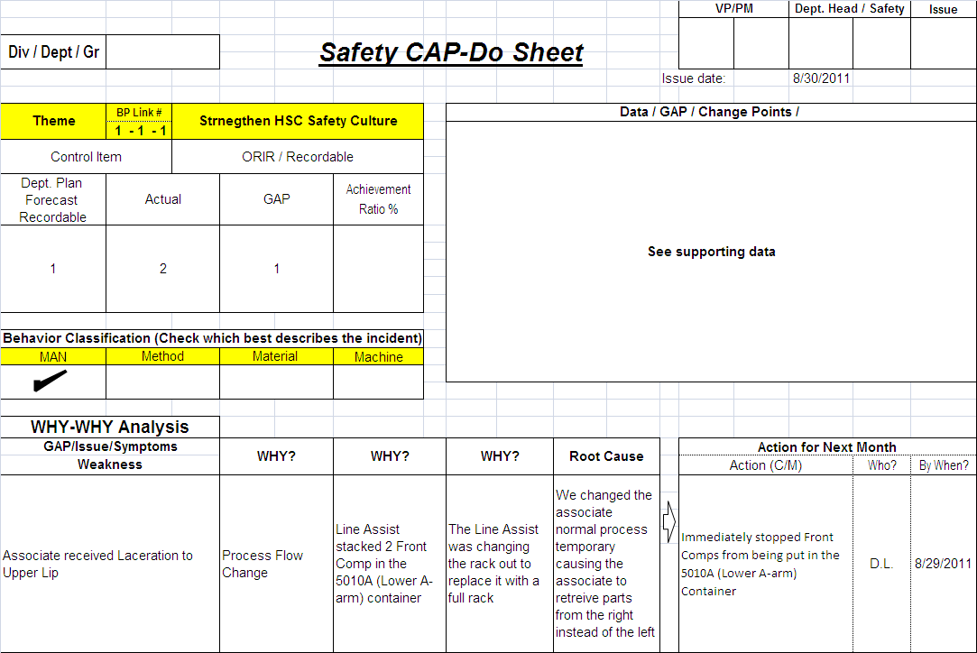
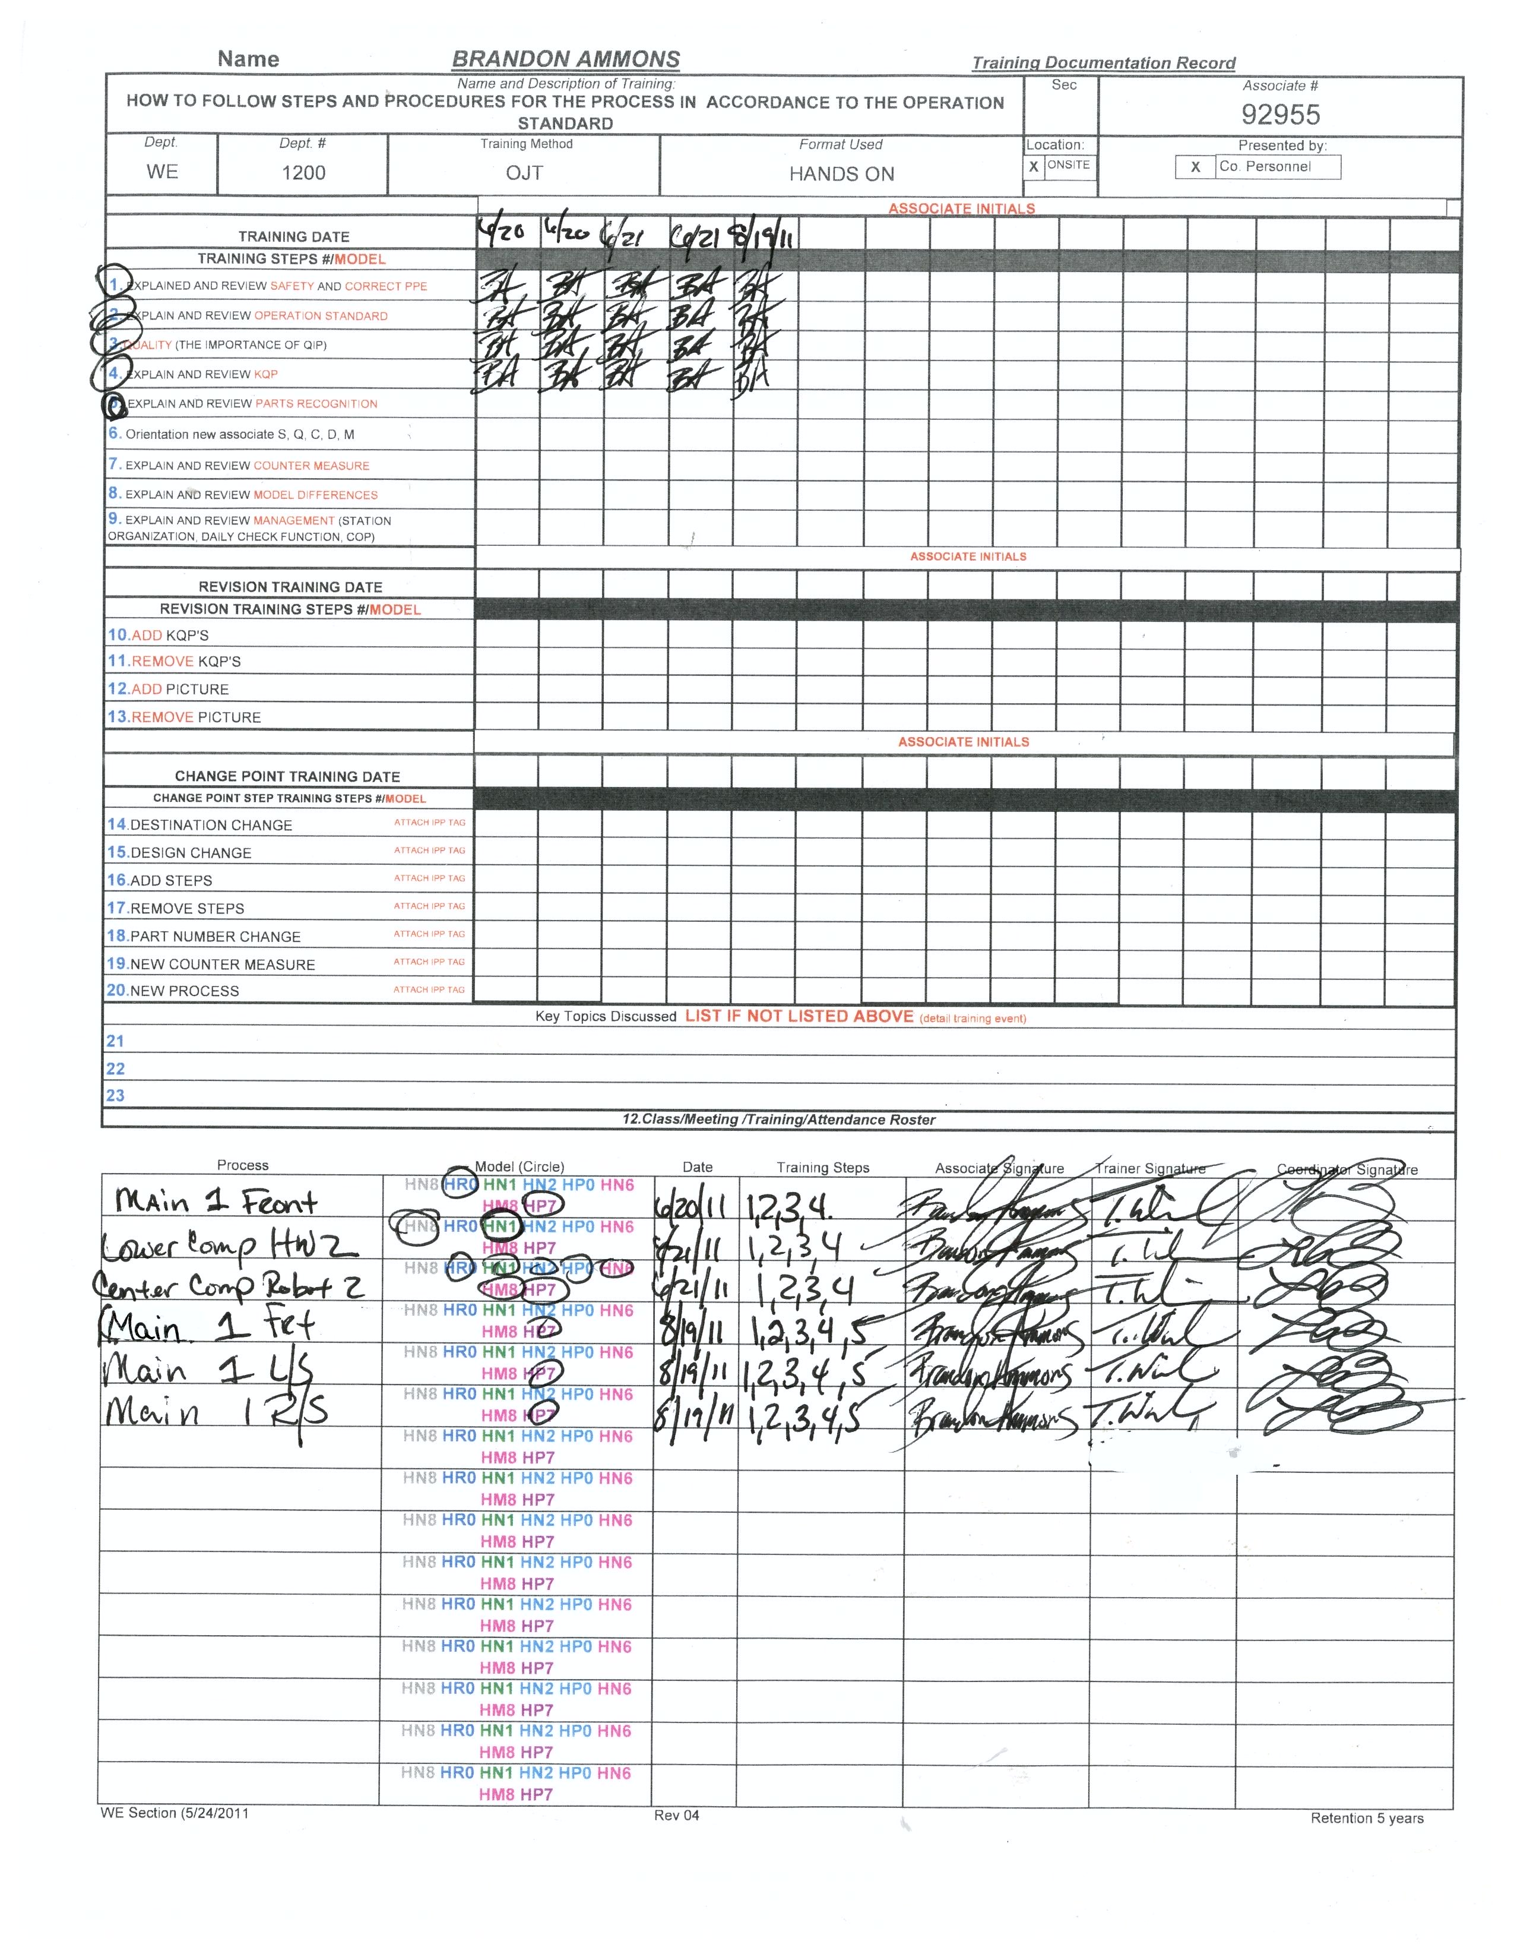
Investigation Data
5Why
Training Report
John Doe
Associate performing Abnormal Process.
Front Comp Pipe
A-3 Container
Mig Welder
Temp Flow Change
from normal process
Main 1 Jig

Slide 13
Benefits of Employer Involvement
Provide Prompt Care and Compensation for the Injured Worker
Reduce Medical Treatment and Cost
Reduce/Avoid Case Litigation and Litigation Cost
Encourage Employer Interest In Safety
Return the Employee Back to Work

Slide 14
Improve Employee’s Self Esteem!

