Slide 1
Getting Involved in Your Claims
A Lawyer’s Perspective
Matt Cook, Esquire

Slide 2
Discovery

Slide 3
Subpoenas: What to do when employer records are subpoenaed
Get established legal counsel through your carrier
Forward subpoena to carrier and counsel
Compile all documents requested in subpoena
Send compiled documents to counsel
Privileged
Protected
Irrelevant
Ramifications for noncompliance: Motion to Compel

Slide 4
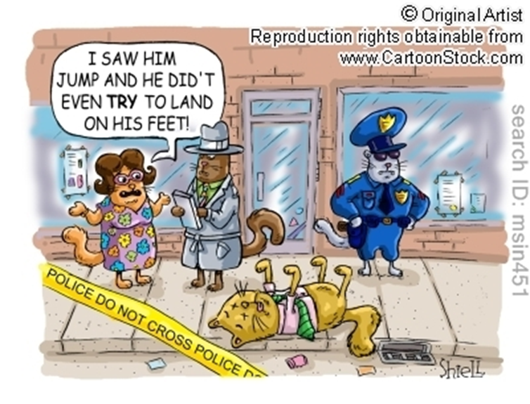
Depositions
Claimant’s deposition
Should I attend?
Reviewing transcript
30(b)(6) deposition
Who should attend on behalf of the employer?

Slide 5
Litigation

Slide 6
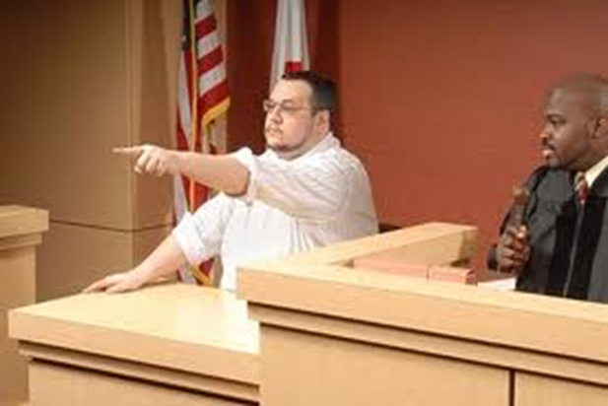
Hearing
Should I attend?
Will I testify?
What should I bring?
Personnel file
Ancillary benefits information

Slide 7
Identify Players Involved
Insurance adjuster responsibilities
Defense counsel responsibilities
Communication with your team
Claims review
Chain of contact for any emergencies

Slide 8
Questions

