Slide 2
KNP Task Group A 3341 Beaded Chenille Stems
An entry in the addition and subtraction strand of the KNP Intervention Guide

Slide 3
Purpose
A 3341
A progression of tasks designed to develop strategies for solving addition and subtraction
Initial levels support counting strategies
Advanced levels use structured images to support more advanced mental strategies that go beyond counting by ones.

Slide 4
Connections to CCSS
A 3341
Activity | Fluency Standard | Targeted Standards
A 3341.0 | 1.OA.6 (within 10) | K.CC.4, K.CC.5
A 3341.1 | 2.OA.2 (within 20) | K.CC.4, K.CC.5
A 3341.2 |  | 1.OA.5, 1.OA.6
A 3341.3 | 2.NBT.5 (within 100) | 1.OA.5, 1.NBT.4
A 3341.4 |  | 1.OA.4, 2.NBT.5
A 3341.5 |  | 1.NBT.4, 1.NBT.5, 2.NBT.5
A 3341.6 |  | 2.NBT.5, 2.NBT.6

Slide 5
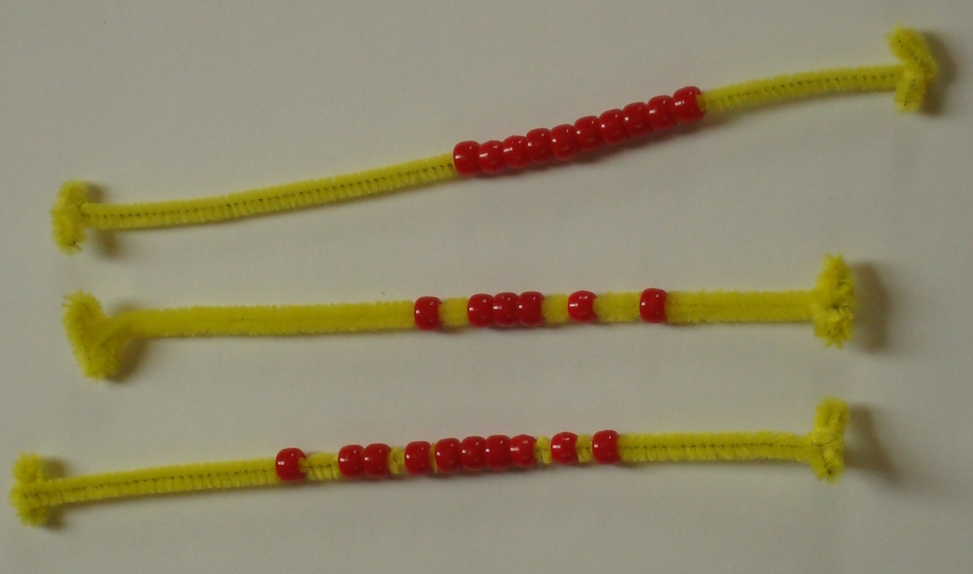
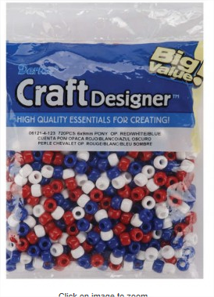
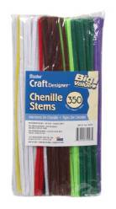
Setting – Beaded Chenille Stems
A 3341
(AKA: Pipe Cleaners with pony beads)

Slide 6
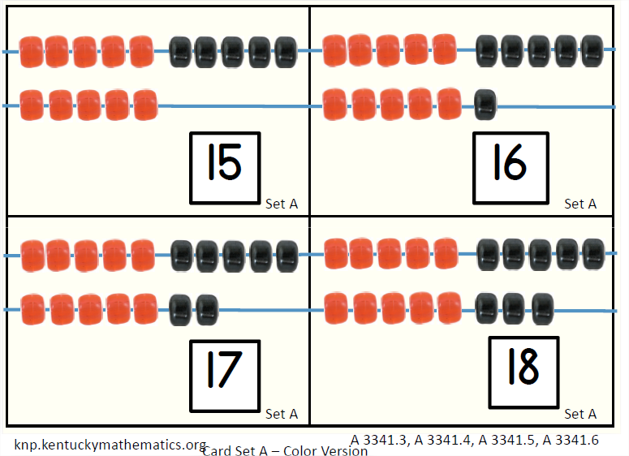
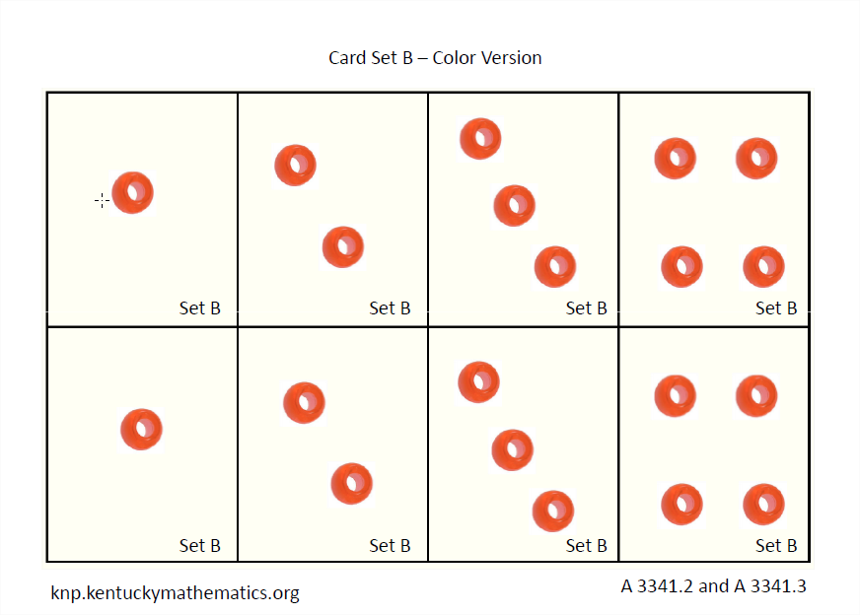
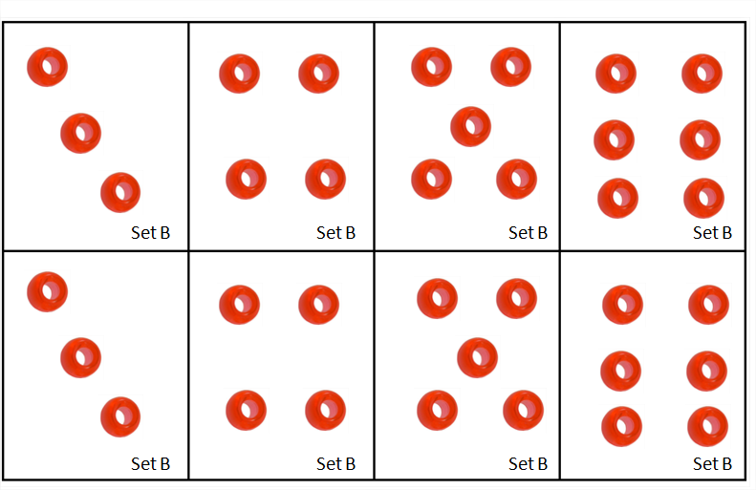
Setting - Cards
A 3341
Cards :
Sets A & C – Showing 9 to 26 beads in row structure
Set B - Showing 1 to 6 beads in a die arrangement

Slide 7
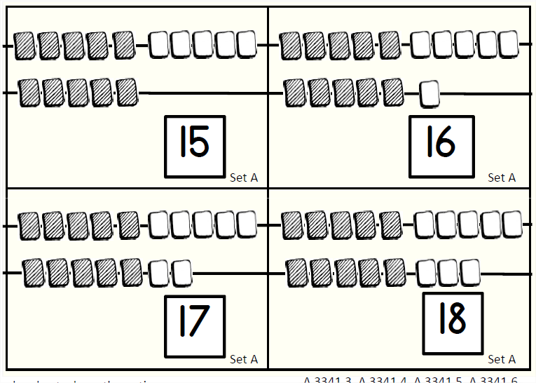
Setting
Cards are available as a PDF in both color and B&W versions.

Slide 8
Task Group
KNP IG Number | Task Name | Description
A 3341.0 | Beaded Chenille Stems (up to 10) | Count beads on one stem (up to 10)
A 3341.1 | Beaded Chenille Stems (total to 10) | Count beads on two stems (total to 20)
A 3341.2 | Beaded Chenille Stems (screened addends) | Determine total of one stem (up to 15 beads) and one card (up to 6 beads) with both screened
A 3341.3 | Bead cards addition (screened addends) | Determine total of one card (up to 26 beads) and one card (up to 6 beads) with both screened
A 3341.4 | Bead cards (find the difference) | Determine the difference of amounts shown on two cards
A 3341.5 | Bead cards (addition strategies) | Determine total of one card (up to 26 beads) and one card (up to 9-11 or 20 beads) with both screened
A 3341.6 | Bead cards (facile addition within 100 | Determine total of up to 4 cards (up to 26 beads each) with all screened

Slide 9
A 3341.0
Beaded Chenille stems (up to 10)
I can…
…carefully count up to 10 items.
Standards: K.CC.4, K.CC.5

Slide 10
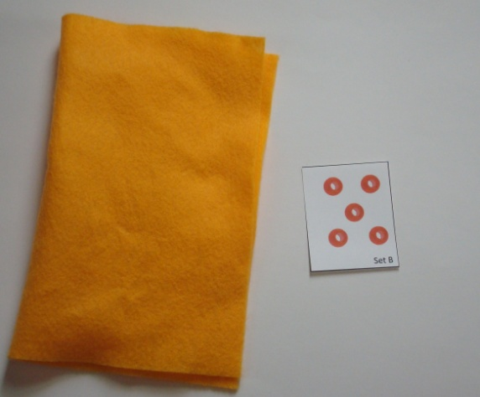
Beaded Chenille Stems (up to 10)
A 3341.0
Preparation
2 to 10 beads on a chenille stem (pipe cleaner).
Bend ends to cover sharp ends and lock beads in place.
Include 5 to 10 stems with various amounts to form a set.
Be sure stems are the same color!

Slide 11
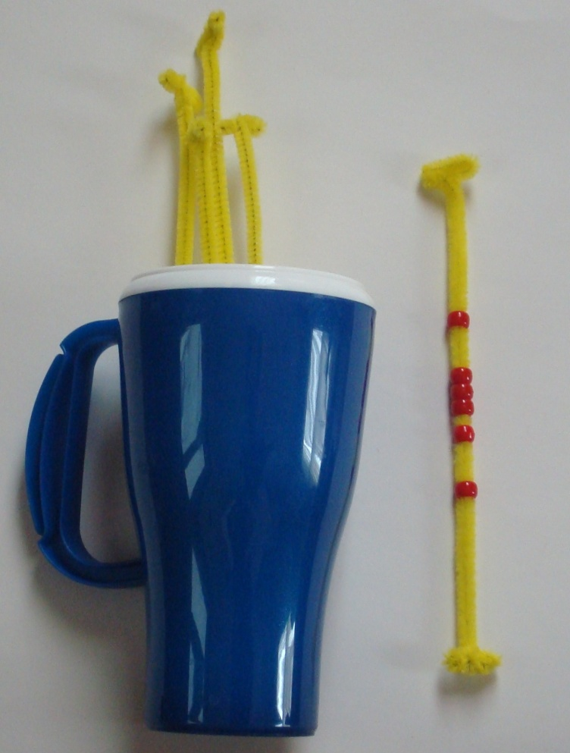
Beaded Chenille Stems (up to 10)
A 3341.0
Place set of beaded chenille stems in a large cup.
During a turn, the student will draw 1 beaded stem. Student will count to determine the number of beads.

Slide 12
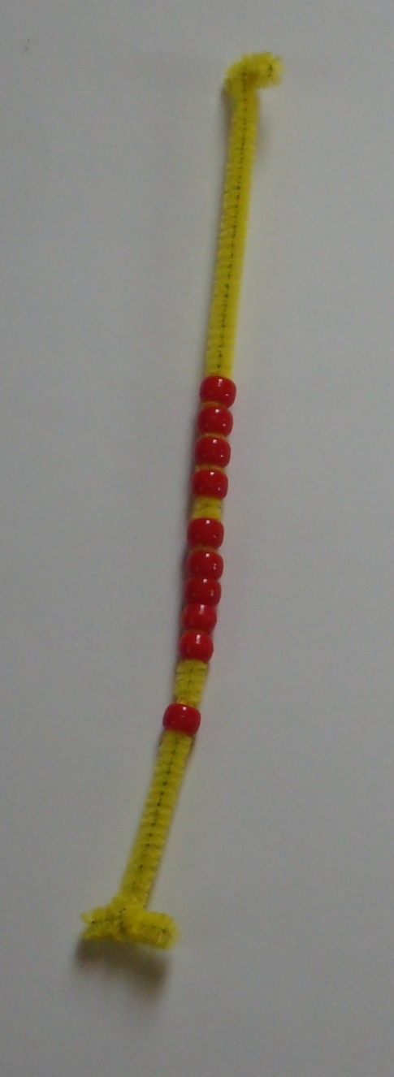
What to notice:
Does the student correctly count the beads?
If the student struggles, consider the cause and then target the response.
For example:
Does the student say the correct number words?
– If not, target number word skills with Nf activities (levels 0 -3).
Does the student associate one bead with each count?
- If not, consider using larger beads or spacing the beads. Or consider asking the student to move beads while counting. Or move to counting loose items not on a stem.
A 3341.0

Slide 13
A 3341.0
Activity Folders
Student directions can be used for making student folders containing the needed materials.

Slide 14
Task Group
KNP IG Number | Task Name | Description
A 3341.0 | Beaded Chenille Stems (up to 10) | Count beads on one stem (up to 10)
A 3341.1 | Beaded Chenille Stems (total to 10) | Count beads on two stems (total to 20)
A 3341.2 | Beaded Chenille Stems (screened addends) | Determine total of one stem (up to 15 beads) and one card (up to 6 beads) with both screened
A 3341.3 | Bead cards addition (screened addends) | Determine total of one card (up to 26 beads) and one card (up to 6 beads) with both screened
A 3341.4 | Bead cards (find the difference) | Determine the difference of amounts shown on two cards
A 3341.5 | Bead cards (addition strategies) | Determine total of one card (up to 26 beads) and one card (up to 9-11 or 20 beads) with both screened
A 3341.6 | Bead cards (facile addition within 100 | Determine total of up to 4 cards (up to 26 beads each) with all screened

Slide 15
A 3341.1
Beaded Chenille stems (total to 20)
I can…
tell the total of two collections with up to 20 items in all.
Standards: K.CC.4, K.CC.5

Slide 16
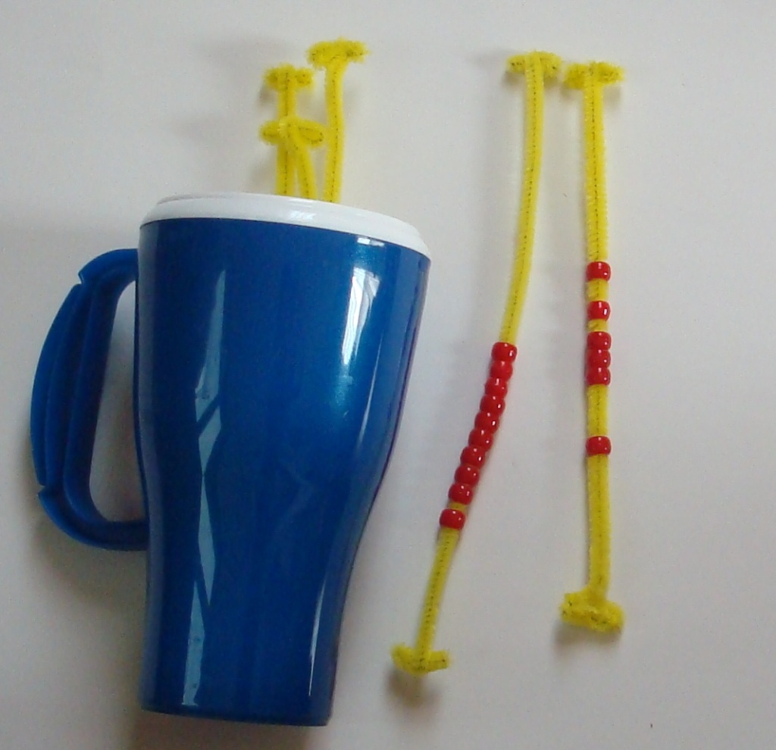
Beaded Chenille Stems (total to 20)
A 3341.1
Set of stems, each with up to 10 beads
During a turn, the student will draw 2 beaded stem. Student will count to determine the number of beads.

Slide 17
What to notice
Does the student correctly count to find the total of two collections?
If the student struggles, consider the cause and then target the response.
For example:
Does the student correctly count the beads on a single stem?
– If not, simplify task to using only one stem (A 3341.0)
Does the student struggle with the number words above 10
– If so, use Nf activities in the range 10 to 20 (level 4).
A 3341.1

Slide 18
A 3341.1
What to notice
Examples continued:
Does the student state the amounts on each stem rather than finding a single sum? - If so, consider
Simplifying the task by showing two addends on a single stem
Finding ways to help student see the two stems as one collection
Ex 2
Ex 1

Slide 19
Task Group
KNP IG Number | Task Name | Description
A 3341.0 | Beaded Chenille Stems (up to 10) | Count beads on one stem (up to 10)
A 3341.1 | Beaded Chenille Stems (total to 10) | Count beads on two stems (total to 20)
A 3341.2 | Beaded Chenille Stems (screened addends) | Determine total of one stem (up to 15 beads) and one card (up to 6 beads) with both screened
A 3341.3 | Bead cards addition (screened addends) | Determine total of one card (up to 26 beads) and one card (up to 6 beads) with both screened
A 3341.4 | Bead cards (find the difference) | Determine the difference of amounts shown on two cards
A 3341.5 | Bead cards (addition strategies) | Determine total of one card (up to 26 beads) and one card (up to 9-11 or 20 beads) with both screened
A 3341.6 | Bead cards (facile addition within 100 | Determine total of up to 4 cards (up to 26 beads each) with all screened

Slide 20
A 3341.2
Beaded Chenille stems
(screened addends)
I can…
tell the total within 20 of two collections when screened.
Standards: 1.OA.5, 1.OA.6

Slide 21
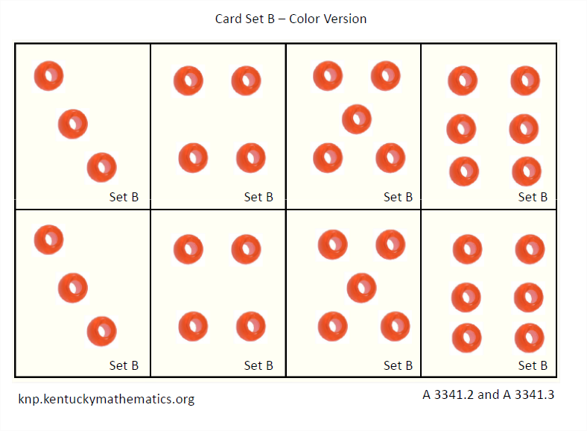
Beaded Chenille Stems (screened addends)
A 3341.2
Materials:
Beaded Chenille Stems (5-15 beads per stem)
Bead cards Set B (1 to 6 beads)

Slide 22
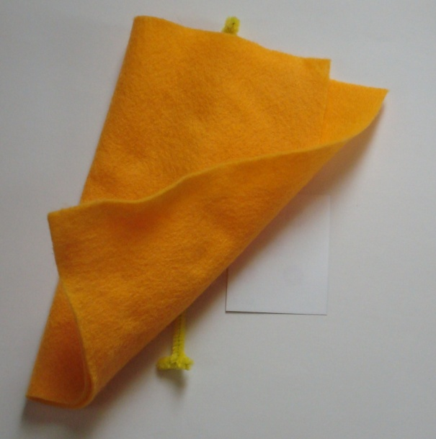
During a turn:
(1) Student will draw 1 beaded stem. Student will count to determine the number of beads.
A 3341.2
(2) Student (or teacher) will place beaded stem under a cover. Student will draw a bead card (with 1 to 6 beads). Student will briefly glance at card.
(3) After a brief glance at the card, the card should be turned over and/or placed under a second cover. Student will determine the total.

Slide 23
A 3341.2
Purpose:
By screening the amounts, students are transitioning from using physical objects to using their own internalized representation of the objects.
This is a significant step to the future goal of connecting a written numeral to an internalized understanding of that quantity.
The second addend is limited to 6. Larger second addends will be introduced when students are ready to use composite strategies when solving.

Slide 24
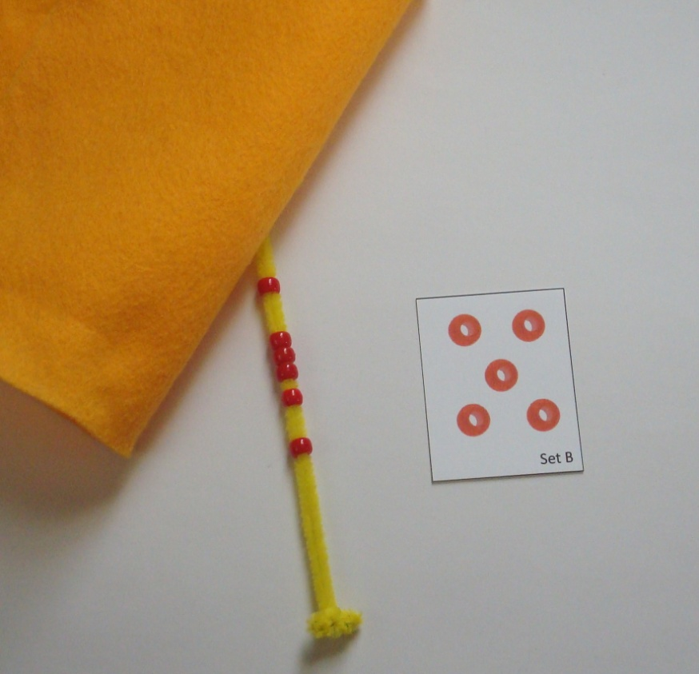
A 3341.2
What to notice:
Does the student have trouble keeping track of the second addend? If so, consider:
using small quantities (1-3) for the second addend and then gradually increasing to 4, 5 and then 6.
leaving one of the addends uncovered.
Does the student count the first addend from one (again)?
– If so, continue with this task!
What strategies does the student have for keeping track of the second addend?

Slide 25
Task Group
KNP IG Number | Task Name | Description
A 3341.0 | Beaded Chenille Stems (up to 10) | Count beads on one stem (up to 10)
A 3341.1 | Beaded Chenille Stems (total to 10) | Count beads on two stems (total to 20)
A 3341.2 | Beaded Chenille Stems (screened addends) | Determine total of one stem (up to 15 beads) and one card (up to 6 beads) with both screened
A 3341.3 | Bead cards addition (screened addends) | Determine total of one card (up to 26 beads) and one card (up to 6 beads) with both screened
A 3341.4 | Bead cards (find the difference) | Determine the difference of amounts shown on two cards
A 3341.5 | Bead cards (addition strategies) | Determine total of one card (up to 26 beads) and one card (up to 9-11 or 20 beads) with both screened
A 3341.6 | Bead cards (facile addition within 100 | Determine total of up to 4 cards (up to 26 beads each) with all screened

Slide 26
A 3341.3
Bead Cards Addition
(screened addends)
I can…
... tell the total within 30 by counting on.
Standards: 1.OA.5, 1.NBT.4

Slide 27
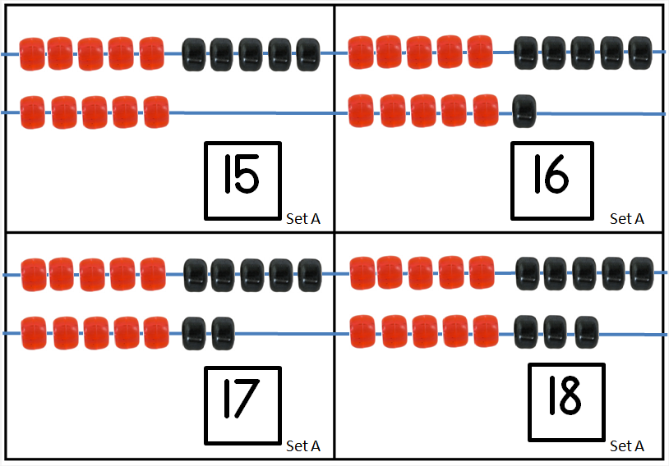
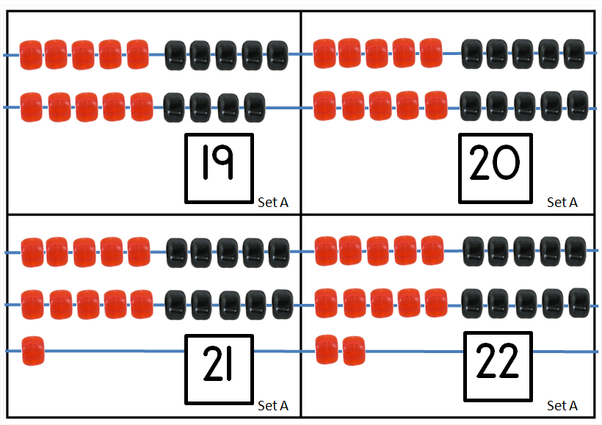
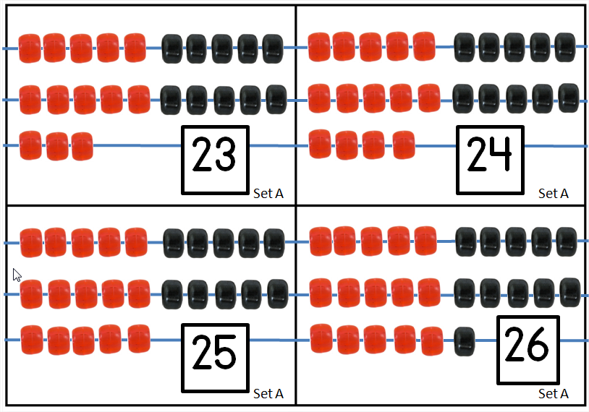
Bead Cards Addition
A 3341.3
Materials:
Bead cards Set A (15 to 26 beads in a structured arrangement)
Bead cards Set B (1 to 6 beads)

Slide 28
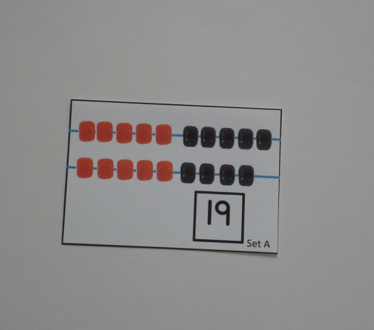
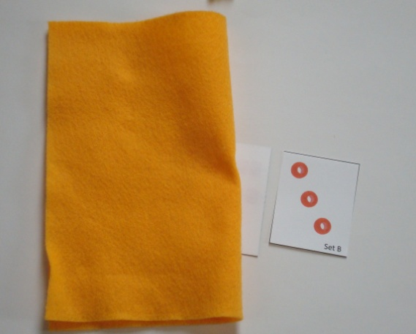
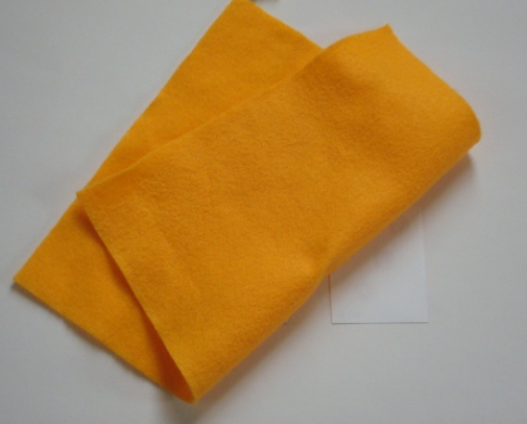
Bead cards Addition
A 3341.3
During a turn:
(1) Student will draw 1 card from Set A. The card will show an amount in the range 15 to 26.
(2) Student will turn over and/or cover the first card. Student will then draw a card from Set B which will show an amount in the range 1 to 6.
(3) After a brief glance at the second card, the student will turn over and/or cover that card as well. Student will then determine the sum.

Slide 29
A 3341.3
Purpose:
The goal is for students to use a count on strategy.
By using large first addends and showing the numeral, students are encouraged to see that first quantity as a whole without the need to count the individual items (i.e. count from 1 to solve)

Slide 30
A 3341.3
What to notice:
Does the student count the first addend by ones?
-If so, continue, while limiting the second addend to a small amount (such as 1-3) or leaving the second addend uncovered.
Does the student have trouble keeping track of the second addend?
-Be sure number word sequence is strong (may need Nf activities)
-Be sure student is confident at level 2 of this task group.
Other instruction:
Subtraction posed with covered materials
Building and reading numbers on a bead rack

Slide 31
Task Group
KNP IG Number | Task Name | Description
A 3341.0 | Beaded Chenille Stems (up to 10) | Count beads on one stem (up to 10)
A 3341.1 | Beaded Chenille Stems (total to 10) | Count beads on two stems (total to 20)
A 3341.2 | Beaded Chenille Stems (screened addends) | Determine total of one stem (up to 15 beads) and one card (up to 6 beads) with both screened
A 3341.3 | Bead cards addition (screened addends) | Determine total of one card (up to 26 beads) and one card (up to 6 beads) with both screened
A 3341.4 | Bead cards (find the difference) | Determine the difference of amounts shown on two cards
A 3341.5 | Bead cards (addition strategies) | Determine total of one card (up to 26 beads) and one card (up to 9-11 or 20 beads) with both screened
A 3341.6 | Bead cards (facile addition within 100 | Determine total of up to 4 cards (up to 26 beads each) with all screened

Slide 32
A 3341.4
Bead cards (find the difference)
I can…
... determine the difference between two sets and write a matching number sentence.
Standards1.OA.4, 2.NBT.5

Slide 33
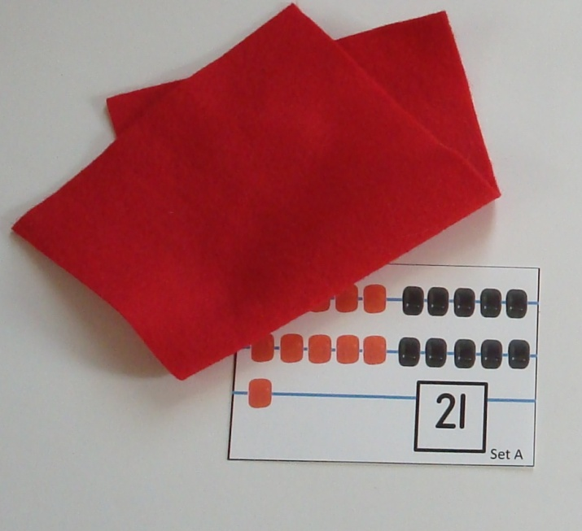
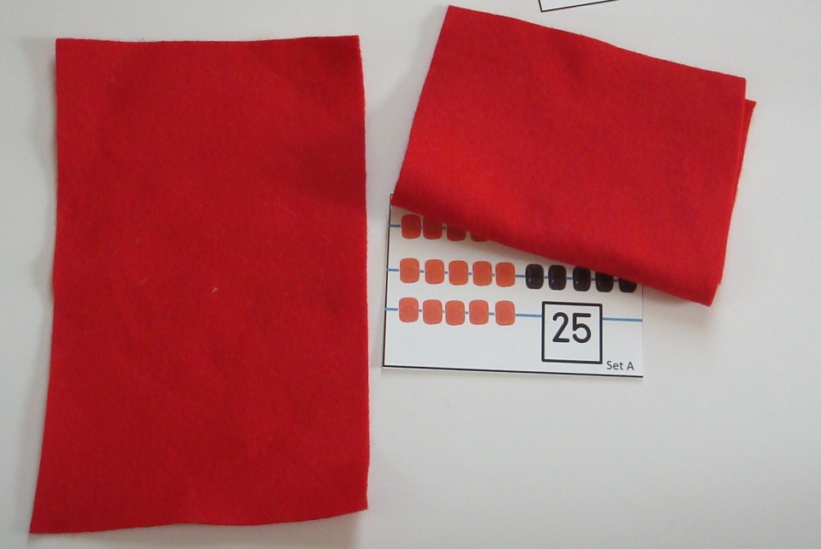
Bead cards – Difference
A 3341.4
Materials: Card Set A (quantities 15-26)
During a turn:
(1) Student will draw 1 card from Set A, look at the card briefly and then turn card face-down and/or cover the card.
(2) The student will then draw a 2nd card from Set A and will cover it after a brief glance. Student will then determine the difference.

Slide 34
A 3341.4
Writing equations
Students can be asked to write a corresponding addition (missing addend) equation or subtraction equation. For example, a student might write:
21 + ___ = 25 → 21 + 4 = 25
OR
25 – 21 = 4 .

Slide 35
A 3341.4
Purpose:
By working with comparison tasks and considering formal ways to record the relationship of the quantities, students will explore connections between subtraction and addition.
Teacher questioning and discussion will be critical to this discovery!

Slide 36
A 3341.4
What to notice:
How does the student keep track of the difference?
-Many students will use fingers to keep track of counts (i.e. put up a finger with each count “22, 23, 24, 25”, look at fingers and say “that’s 4”)
-Others may use prior structuring knowledge (i.e. 1 + 4 = 5 so 21 + 4 = 25.

Slide 37
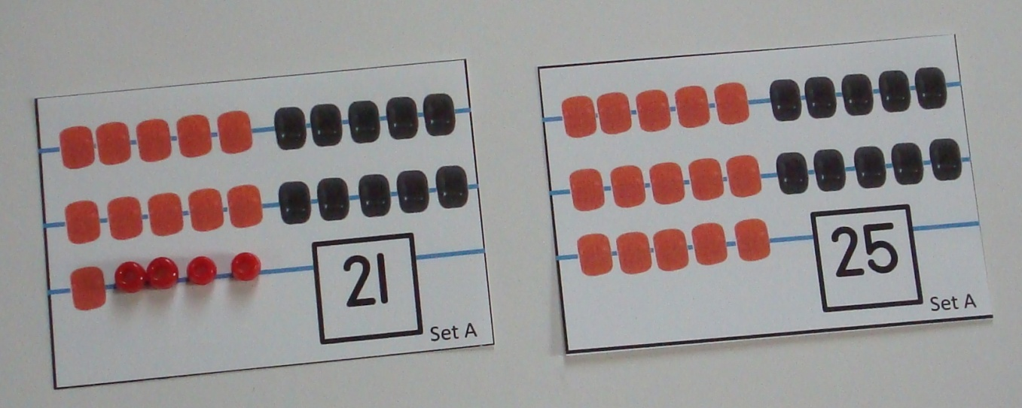
A 3341.4
What to notice:
Is the student struggling?
-Uncover the cards (or one of the cards)
-Ask “How many beads do you need to add (to the small one) to make them equal?” Student might even use beads to work out the task initially.

Slide 38
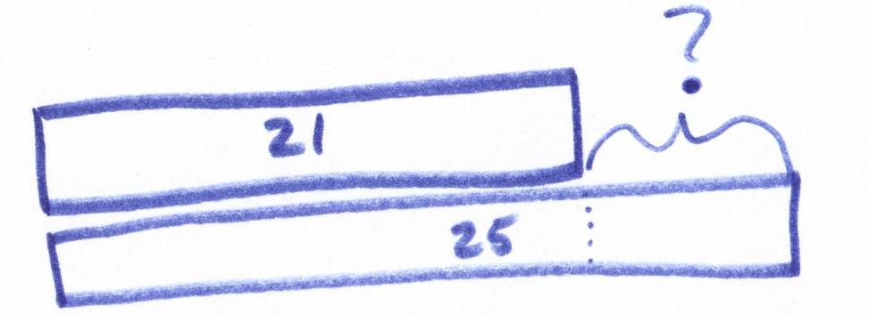
A 3341.4
Notation and Recording
Student may find it helpful to see their thinking on an Empty Number Line or by a bar model
Example: 21 + ___ = 25
Models such as these will help students extend their reasoning to problems involving larger numbers (i.e. 251 + __ = 284)

Slide 39
Task Group
KNP IG Number | Task Name | Description
A 3341.0 | Beaded Chenille Stems (up to 10) | Count beads on one stem (up to 10)
A 3341.1 | Beaded Chenille Stems (total to 10) | Count beads on two stems (total to 20)
A 3341.2 | Beaded Chenille Stems (screened addends) | Determine total of one stem (up to 15 beads) and one card (up to 6 beads) with both screened
A 3341.3 | Bead cards addition (screened addends) | Determine total of one card (up to 26 beads) and one card (up to 6 beads) with both screened
A 3341.4 | Bead cards (find the difference) | Determine the difference of amounts shown on two cards
A 3341.5 | Bead cards (addition strategies) | Determine total of one card (up to 26 beads) and one card (up to 9-11 or 20 beads) with both screened
A 3341.6 | Bead cards (facile addition within 100 | Determine total of up to 4 cards (up to 26 beads each) with all screened

Slide 40
A 3341.5
Bead cards (addition strategies)
I can…
... use composite strategies to add within 50.
Standards: 1.NBT.4, 1.NBT.5, 2.NBT.5

Slide 41
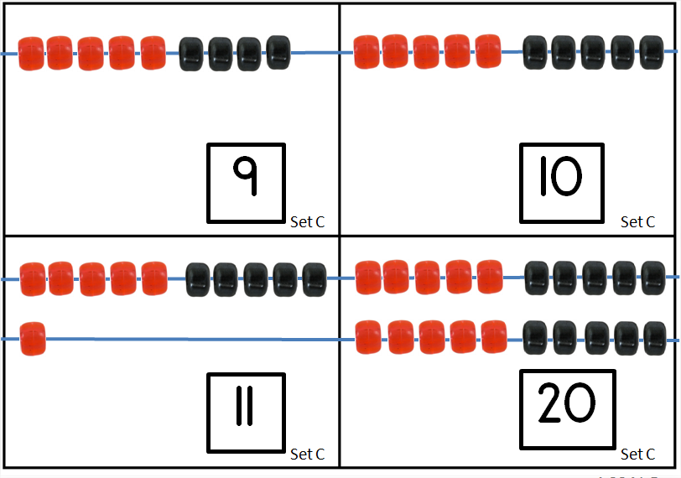
Bead Cards Addition
A 3341.5
Materials:
Bead cards Set A (15 to 26 beads in a structured arrangement)
Bead cards Set C (9, 10, 11 or 20 beads)

Slide 42
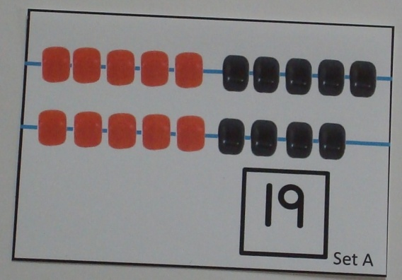
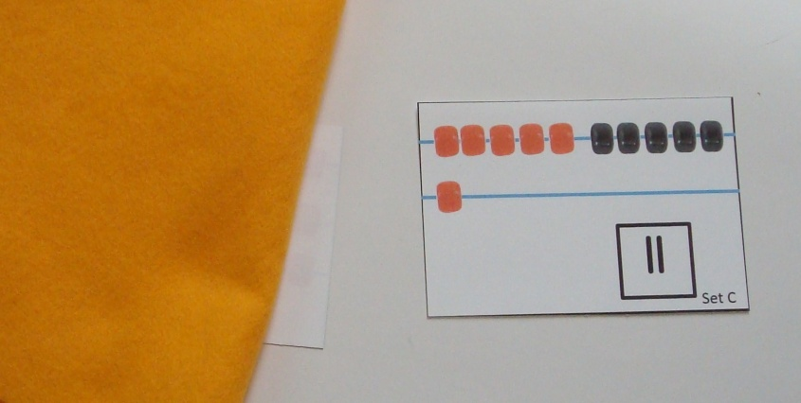
During a turn:
(1) Student will draw 1 card from set A.
A 3341.5
(2) Student (or teacher) will cover (or turn over) the card. Student will then draw a card from set C.
(3) After a brief glance at the card, the card should be turned over and/or placed under a second cover. Student will determine the sum.

Slide 43
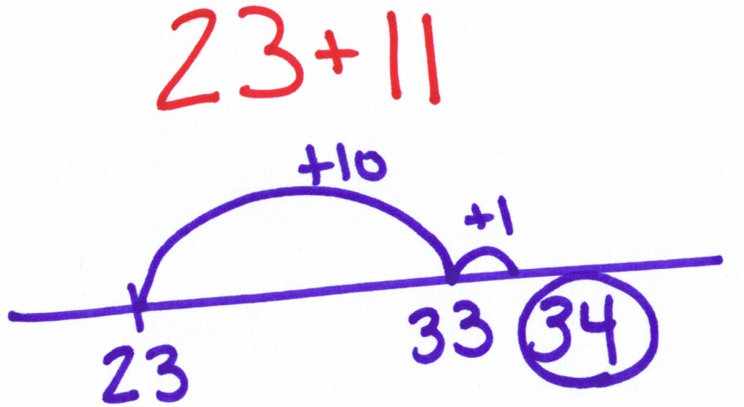
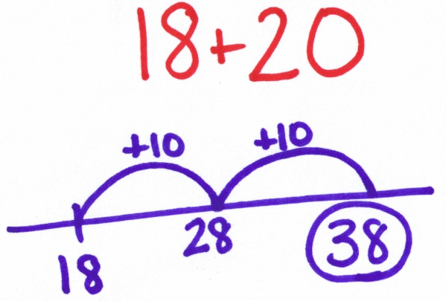
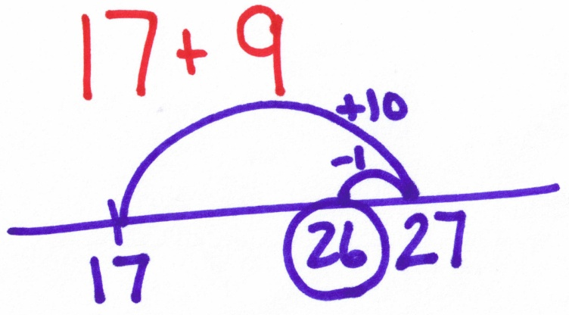
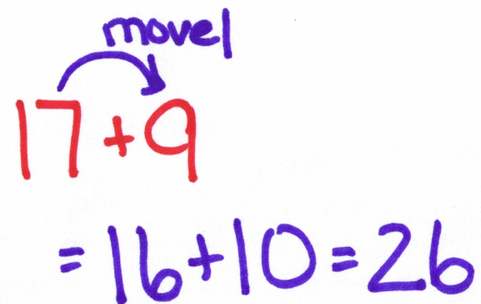
A 3341.5
Purpose:
The amounts in set C (9, 10, 11 & 20) are intentionally chosen to highlight the strategy of using the 10.

Slide 44
A 3341.5
What to notice:
Does the student add “10” as a chunk?
-If not, student may benefit from work with a 10 row bead rack (adding rows of 10) or other base 10 setting
Does the student use chunks of “10” when adding 9, 11 or 20?
-Use questioning and supportive materials to bring out connections
-Record strategies using an Empty Number Line
-Continue with the activity!

Slide 45
Task Group
KNP IG Number | Task Name | Description
A 3341.0 | Beaded Chenille Stems (up to 10) | Count beads on one stem (up to 10)
A 3341.1 | Beaded Chenille Stems (total to 10) | Count beads on two stems (total to 20)
A 3341.2 | Beaded Chenille Stems (screened addends) | Determine total of one stem (up to 15 beads) and one card (up to 6 beads) with both screened
A 3341.3 | Bead cards addition (screened addends) | Determine total of one card (up to 26 beads) and one card (up to 6 beads) with both screened
A 3341.4 | Bead cards (find the difference) | Determine the difference of amounts shown on two cards
A 3341.5 | Bead cards (addition strategies) | Determine total of one card (up to 26 beads) and one card (up to 9-11 or 20 beads) with both screened
A 3341.6 | Bead cards (facile addition within 100 | Determine total of up to 4 cards (up to 26 beads each) with all screened

Slide 46
A 3341.6
Bead cards (facile addition within 100)
I can…
... use composite strategies to add within 100.
Standards: 2.NBT.5, 2.NBT.6

Slide 47
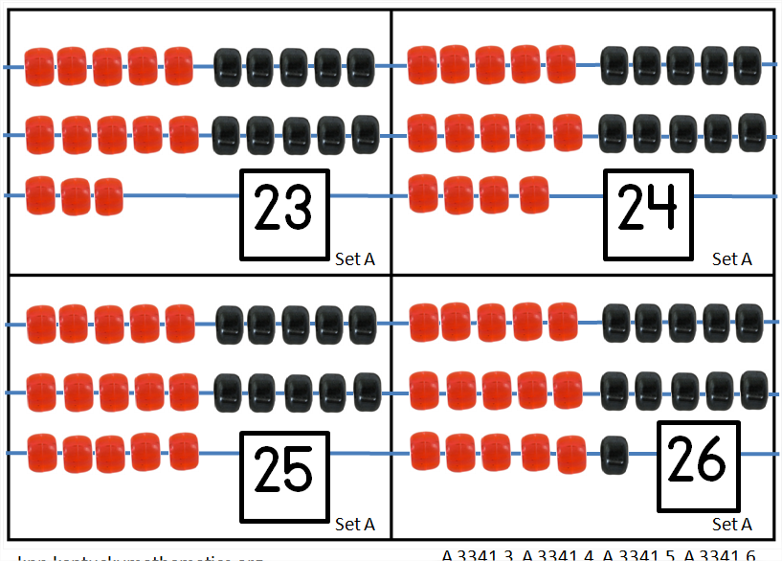
Bead Cards Addition
A 3341.3
Materials:
Bead cards Set A (15 to 26 beads in a structured arrangement)

Slide 48
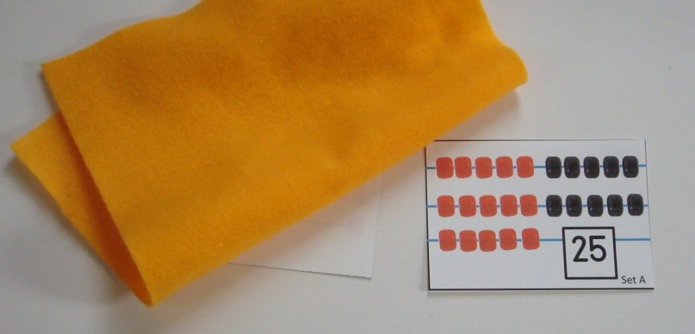
A 3341.6
During a turn:
Student will draw a card from set A and, after a brief glance, cover or turn over the card.
Student will draw a second card from set from set A and cover.
Student will find the
sum.
Students can be directed to draw up to 4 cards in all. Students may write the addends down as each cards is drawn

Slide 49
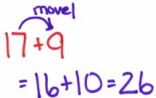
A 3341.6
Purpose:
Students will flexible add two digit numbers in the range of 100 using a variety of math strategies.
Discussion, which includes comparing the efficiency of strategies, is fundamental.

Slide 50
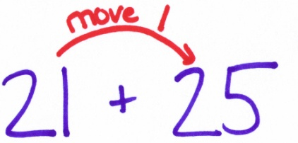
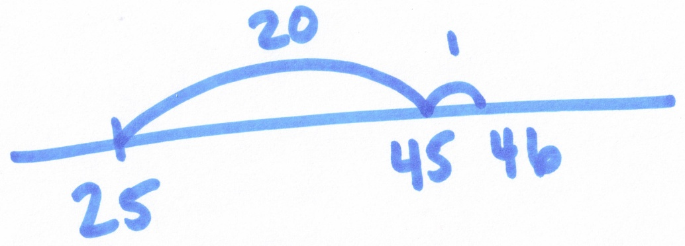
A 3341.6
Composite (Non-count-by-one) strategies:
Students may choose from a variety of strategies to solve. For example, for 21 + 25 the student might do one of the following:
Split Strategy:
21 = 20 + 1
25 = 20 + 5
20 + 20 = 40
1 + 5 = 6
Transformation :
“Move” 1 from the 21 to the 25, to create the equal but easier problem “20 + 26”.
Written symbolically:
21 + 25
= (20 + 1) + 25
= 20 + (1 + 25)
= 20 + 26
= 46
46
Jump Strategy:

Slide 51
Thank You!
Please visit knp.kentuckymathematics.org for more information.

